Slide 1
TCL AS A AUTOMATION TOOL
European Tcl/tk user meeting 2017, Berlin
Leonid Vovchuk

Slide 2
CONTENT
Preamble : FEM methods
Creation of meta-languages
Automation of full cycle of mechanical calculation
Binary data

Slide 3
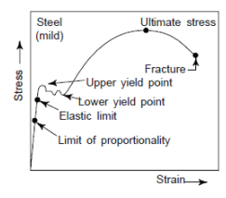
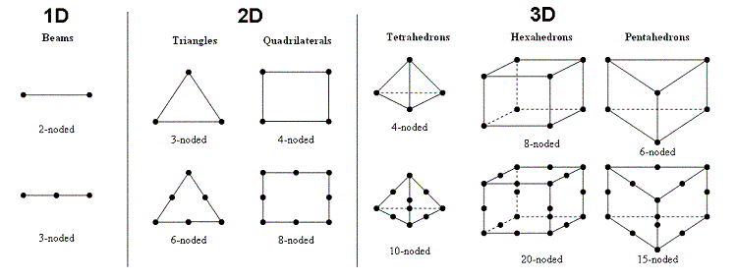
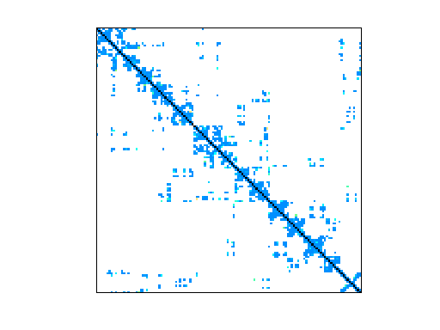
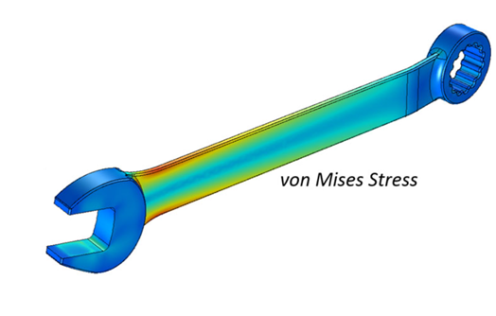
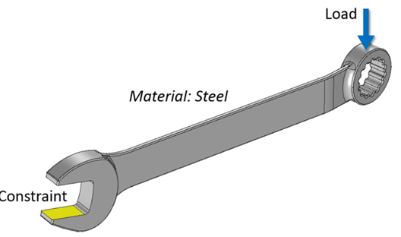
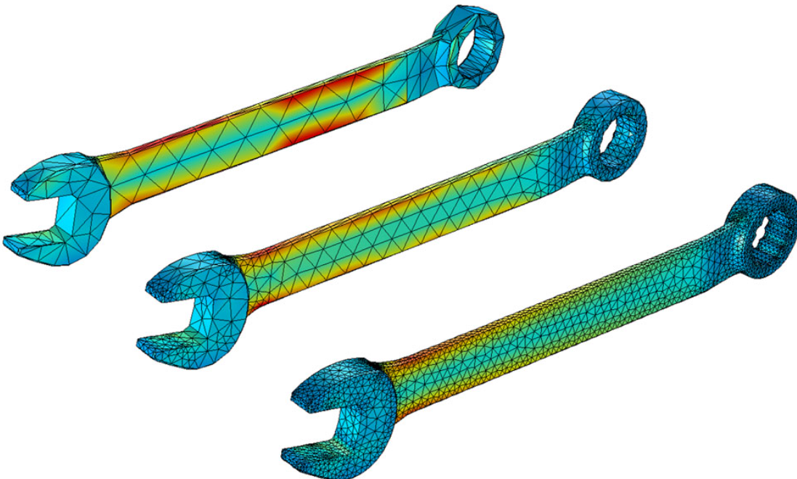
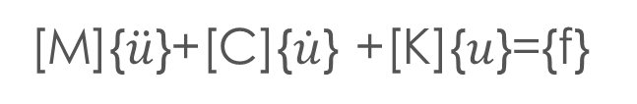
Finite Elements Method
Geometry → mesh → FE model → system of equations → displacements → derived results
[K]{u}={f}
[K(u)]{u}={f(u)}
[K]{u}=λ[M]{u}
[M]{$\ddot{u}$}+[C]{$\dot{u}$} +[K]{$u$}={f}

Slide 4
MECANICAL FEM WORKFLOW
Geometry
Meshing
Preprocessing:
Materials
Properties
Constraints
Loads
Temperature’s interpolation
Postprocessing :
Visualization
Critical zones search
Derived results calculation
Presentation of results :
Pptx, reports docx, xlsx
Thermal calculation’s results
Calculation
Special calculations
Chane of topology, parameters
Analysis of the results

Slide 5
ONE EXAMPLE \ NUMBERS
Geometry
Meshing
Preprocessing:
Postprocessing :
Presentation of results :
670k nodes
2.3M tetra
0.78M tria
12M DOFs
80 timesteps
DB Patran 880Mb
80 critical zones
DB Patran 3.6Gb
360 slides
790 images
DES/FAC : 50Gb
Txt reports : 6Gb
DAT : 1.7gb → 12 x 350Mb
Thermal calculation’s results
Calculation
Special calculations
7modeles x 200Mb
18h x 12 = 216hours
260Gb on disk
450M → 12T nonzeros
LCF calculation :
2hours
6.6Gb

Slide 6

MECANICAL FEM WORKFLOW
Geometry
Meshing
Preprocessing:
Postprocessing :
Presentation of results :
Automation of all actions
Picture dumping
Zoning
Searching extremums
Derived results calculation
Assembling
modification
morphing
Generating of all documents
Verification
Modification
Thermal calculation’s results
Calculation
Special calculations
Adaptation of thermal model
Automation of external modules, calculations
Servers management
Elements of PDM

Slide 7
1 META-LANG: CONTENT
PATRAN Command Language (PCL)
Package PATRAN
Package MS.OFFICE

Slide 8
META-LANG
package PATRAN
package ALGEBRA
SES* SES/Z001_thermal_groups
db_open? $db1
:!! th1
+ node<elem<group 3D.CVTE
+ node<elem<group 3D.SUPPORT_CVTE
:!! th2
+ node<num 1:#
- node<group th1
neutral_export RPT/Z_env.out a -node -group th1
neutral_export RPT/Z_trv.out a -node -group th2
*SES
set v [|= $x $y $z]
set v [av+bw 1.0 $v -1.0 $zer]
set pc [vw $axx $v]
set v [av+bw 1.0 $v [expr -$pc] $axx]
set r [|v| $v]
set v [|v|=1 $v]
package CDB
@demand class node type BODY1 = obj
@ $id x y z = x1 y1 z1
@= $id x y z $x $y $z
@p= $id color green
@p* color green class node = ids
@newfield $obj dist vector double
package DATATABLE
||
|| VISU_CHAPE
|| CLASS DCPG_XLS
|| FILE |MISSION|_CHAPE
|| &CURVE DEPOU_CHAPE
|| &SELECT DECOUPAGE_CHAPE
|| * | TYPE CURVE SELECT NAME
|| -----------------------------------------------------------------------------------------------------------------------------------------------------------------------------------------------------
|| CLEAN | CLEAN - - -
|| DESCRIPTION | DESCRIPTION - DESCR=* descr
|| SUMMARY | SUMMARY TOT=* - summary
|| TOTAL1 | CRVS TOT=1 - X_gradients
|| TOTAL2 | CRVS TOT=2 - X_curves
|| ALL | CRV TOT=* - X_(curve)
|| -----------------------------------------------------------------------------------------------------------------------------------------------------------------------------------------------------
||

Slide 9
PCL
uil_file_open.go("1.db")
auto_extend( FALSE )
auto_fitview( FALSE )
ga_group_create("work")
ga_group_current_set("work")
ga_group_clear("work")
STRING ARG1[VIRTUAL]
uil_list_a.clear()
list_create_target_list( "lista", "Elem 326375 392167 156706 760063 385640 46206@
4 912239 10384 536220 264119 48116 689930 668821 886425 150251 278657 394196 268@
249 471196 406640 408057 227190 382363 377776 287178 604811 64604 813644 920738 @
849896 205275 69003 748908 907672 259169 858499 793104 701476 715508 544135 2845@
42 303562 967904 575700 803834 42084 322514 501431 551563 130174 840074 130344 7@
05433 219188 903574 370887 513466 832349 300176 67030 583095 91320 829698 735796@
538355 138614 698331 854597 226232 283740 830623 296372 125648 774730 898224 46@
2434 135510 518769 953454 713570 973987 809245 995163 706743 235391 224643 59064@
8 26577 692569 8052 336011 340823 224651 721411 759942 346292 134456 811013 7109@
…
Patran writes a session file with almost all actions which can be replayed
Commands are numbering depended - no reutilization for different models
Difficult and too much detailed format for fast scripting
res_display_report_create("1","Elements", 1, list_group, 24, @
["ReportType:Full", "ReportTitle:$PRODUCT - Analysis Code: $CODE_NAME ",@
"ReportTitle:", "ReportTitle:Load Case: $LC_NAME, $SC_NAME ", "ReportTitle:",@
"ReportTitle:Result $PRES_NAME, $SRES_NAME - Layer $LYR_NAME ", "ReportTitle:",@
@
"ReportTitle:Entity: Element Tensor", "ReportHeader:Page $PAGE", "ReportFooter:$@
DATE",@
"ReportPage:Height=52,Width=128,TopMargin=5,LeftMargin=8,BottomMargin=5", "Repo@
rtPagination:OFF",@
"ReportPageNumber:1", "ReportPageAlignment:Center", "ReportTColumn:1,Entity ID,@
ID,%I12%", @
"ReportTColumn:2,El. Pos. ID,EPID,%I6%", @
"ReportTColumn:3,X Component,XX,%E12.6%", "ReportTColumn:4,Y Component,YY,%E12@
.6%", "ReportTColumn:5,XY Component,XY,%E12.6%", @
"EntitySort:LoadCase", "ValueSort:1,Ascending,Algebraic", "ColumnHeaders:ON", "F@
ilter:None",@
"ScaleFactor:1."] )
res_display_report_write( "1", 0, "Tensor", "Element", "Overwrite", "RPT/0000A_H@
CF_HCFBP_E3431_ELEM.rpt" )

Slide 10
PATRAN GROUPS / LIST PRECESSOR
Groups : named components containing a set of entities
List processor is a tool for selection of the entities according to its properties, coordinates or interconnection

Slide 11
PACKAGE PATRAN
Special tcl commands which add a string to a SES file
Commands are shorts and simples
Working with coordinates and groups makes it possible to generate the number- independent scripts
db_open? Ite1.db
: part1
+ elem<node<mpc<group PART_1
- node<X>,Y~,Z= “1.0 [list 0.01 0.02] 20.0 –in group1 –coord 100”
+elem& work1 work2

Slide 12
PATRAN SCRIPT
loadcase Default –current ;# make load case current
foreach sec {01 04 05 08 09 12} {
:!! tol ;# create and clear a group
+ node<group AXST$sec ;# add nodes from other group
+ elem<node<group tol
stick ax$sec 0.5 node<group VIST$sec tol ;# creating connection
}
swapnodes 1e-10 1 node<group AXST$sec node<group VIST$sec
db_import $::axedb -elem + -groups $noma
:rename $noma AXE$rrr
:rotate AXE$rrr [expr ($rr-1)*360/double($N)]
point [expr 100+$rr] $XCHAPE $y $z
coord [expr 200+$rr] -zero $XCHAPE $y $z -x 0 1 0 -y 0 0 1 cyl
:!! work
+ node<elem<group 2D_VIROLE$rrr
:!! hole$rrr
+ node<X=,Z~ [list $RAD "$XCH0 $XCH1" -in work -coord [expr 200+$rr]]

Slide 13
PATRAN SCRIPT
STRING LC_NAME[80]
STRING SC_NAME[80]
IF (FIND_LOADCASE("ASEF",1,lc_name,sc_name) == 1) THEN
res_data_load_dbresult( 0, "Nodal", "Vector", lc_name, sc_name, "Deplacements no@
daux (DX,DY,DZ)", "[Code 163]", "(NON-LAYERED)", "", "AsIs", "", "", "", "", 0.@
)
res_data_title( 0,"Nodal","Vector", 1, ["$PT: $LCN, $SCN, $PRN, $SRN, $DRVL, $LN@
"])
coloring_method(1)
res_display_deformation_create("","Elements", 0, [""], 9,@
["DeformedStyle:Red,Solid,1,HiddenLine",@
"DeformedScale:Model=0.1","UndeformedStyle:OFF,Blue,Solid,1,HiddenLine",@
"TitleDisplay:ON", "MinMaxDisplay:ON", "ScaleFactor:1.", "LabelStyle:Exponential@
, 12, White, 3",@
"DeformDisplay:Resultant", "DeformComps:OFF,OFF,OFF"] )
res_display_deformation_post( "", 0 )
END IF
IF (FIND_LOADCASE("ASEF",1,lc_name,sc_name) == 1) THEN
res_data_load_dbresult( 0, "Nodal", "Scalar", lc_name, sc_name, "Deplacements no@
daux (DX,DY,DZ)", "[Code 163]", "(NON-LAYERED)", "MAG", "AsIs", "", "", "", "",@
0. )
res_data_title( 0,"Nodal","Scalar", 1, ["$PT: $LCN, $SCN, $PRN, $SRN, $DRVL, $LN@
"])
res_display_fringe_create( "", "FreeFaces", 0, [""], 12, @
["Range:Fri_default_Fringe", "RangeOverwrite:ON", "FringeStyle:ElemFill", "Shade@
:None", @
"ElemEdge:FreeEdge,Blue,Solid,1", "Shrink:0", "TitleDisplay:ON", "MinMaxDisplay@
:ON", "ValueDisplay:OFF", "Filter:None", "ScaleFactor:1.", @
"LabelStyle:Exponential, 12, White, 3"], TRUE )
res_display_fringe_post( "", 0, "Nodal", TRUE, TRUE )
ga_db_range_set_label_control_m( 1, "", "", "mm", 2, "Fri_default_Fringe")
ga_db_range_set_label_style_m(1, 7,1 , 12, 3, 2, "Fri_default_Fringe")
END IF
gm_write_image( "PNG", "PIC/spl_1.png", "Overwrite", 0., 0., 1., 1., 0, "Viewpor@
t" )
plot.defo ASEF 1 -coef 1000.0 -simple 1
plot.elem ASEF 1 -code " 163" -selection MAG -edge FreeEdge
picture.dump PIC/spl_1.png PNG

Slide 14
MS OFFICE : TWAPI COM
if {$key=="count"} {
set sh [xsheet $ab $sheet]
set c [[$sh ChartObjects] Count]
return $c
} elseif {$key=="select"} {
set sh [xsheet $ab $sheet]
[[$sh ChartObjects] Item [expr $i]] Activate
[[[[$sh ChartObjects] Item [expr $i]] Chart] ChartArea] Select
} elseif {$key=="delete"} {
set c [[[$application ActiveChart] SeriesCollection] Count]
if {$i>=$c} {
[[[$application ActiveChart] SeriesCollection] Item [expr int($i)]] Delete
}
} elseif {$key=="add"} {
set ActiveChart [$application ActiveChart]
set nom [[$application ActiveSheet] Name]
set xcol [expr $xcol]; set ycol [expr $ycol]; set start [expr $start]; set end [expr $end];
[$ActiveChart SeriesCollection] Add [xls.range 1 1 2 1 -obj $obj]
set count [[$ActiveChart SeriesCollection] Count]
if {$count==0} {error "can not insert gra"}
set item [[$ActiveChart SeriesCollection] Item [expr int($count)]]
…

Slide 15
MS OFFICE : PACKAGE
xls.open ${DER}_SUMMARY.xlsx
xls.sheet activate SOUPLESSE
xls.replace (FILE) [file tail $f2] (DATE) $w2 (TIME) $w3]
set f [open [file join $ref ${DER}_mass.txt] r]
while {![eof $f]} {
gets $f str
if {[regexp {MASS\s+(.+)} $str --> m]} {
..
}
}
close $f
ppt.new
xls.select 1 1 20 30
xls.copy
ppt.paste 10% 20% -witdth 50%
ppt.image 20.png –left 5% -top 5% -width 90% -height? 40%
xls.save
xls.close
ppt.save

Slide 16
AUTOMATION
Many SES files are created in one Tcl script, sharing all tcl-variables
BAT is created for running PATRAN in batch mode
STEP-BY-STEP WORK
set ITE 4010
set db ITE${ITE}_LCF.db
…
SES* SES/001_out_dump -b
db_open? $db
|*| VOLUME SKIN=1 >> *neutral -out $outfile -type s
# creating group for ZAT
:!! SD.ZATS
+ elem<group* 2D.*ZAT*
+ elem<group SD.SOUD_ZAT_MO
:!! SD.CORDONS
+ elem<group* 2D.*CORDON*
+ elem<group SD.SOUD_CORDON_MO
neutral_export ZAT$ITE.out gr -group SD.CORDONS SD.ZATS
db_close
*SES
SES * SES/002_post_pictures -b
db_open? $db
…
*SES

Slide 17
TWO LEVEL SCRIPTING
Do the same as for SES* *SES → TCL* *TCL
Main script does nothing but prepare everything – builds worker scripts
BAT file is also provided
Sharing the same variables for different steps (PATRAN or TCL)

Slide 18
TCL**TCL package
TCL* - start script, *TCL – end script
tcl+ - add some code
tcl+pkg – ask for packages
tcl+var – pass some variables
tcl+exit – stop log and exit
tcl+src – source\load
# variables
set s ITE001
…
SES* SES/${s}209_load_compare -b
db_open? $db3
sf_play RPT/${DER}_compare_nod_load.ses
*SES
TCL* SES/${s}210_archiving -b
tcl+pkg 7ZIP
tcl+src m.tcl d64.dll
tcl+var db3 DER PREFIX
tcl+ {
szip::compress $db3 $db3 -v500m
file rename -force $db3.7z $OUTCOME
file copy -force ${DER}_SOUPLESSE_A7.xlsx $OUTCOME
} catch 1
tcl+exit
*TCL

Slide 19
OTHERS
BAT* *BAT – some bat commands
WB* *WB – python script for WB
JS* *JS – for some WB modules
foreach s {1 2 3 4} {
BAT* SES/${s}203_savedat
bat.db.convert64 64$db2
bat.patsam64 $PREFIX${s}_$calcul
bat.file.move ${s}_$calcul.dat DAT/
bat.file.move ${s}_$calcul.msg DAT/
bat.file.move ${s}_$calcul.jba DAT/
*BAT
}
??
C* mesh.c
c+ {
…
}
*C

Slide 20
EXAMPLE 1/8
package require PATRAN
package require TCL**TCL
package require DT.PATRAN
#######################################
set ITE 1000F
set PREFIX EM20170605
|xls| souplesse_cvte.xlsx
set calcul SOUPLESSE_CVTE
set DER DER$ITE
|var| SOUPLESSEIMAGE //ws85/E/usr/sr00004/PROJECTS/SM027-15-C_LEAP-B_TRV/TRV_DERO/SCRIPTS/SOUPLESSE_CLOISON.png
set db1 ${PREFIX}DER1000Z_$calcul.db
set db2 ${PREFIX}DER${ITE}_$calcul.db
set db3 ${PREFIX}DER${ITE}_${calcul}_RES.db
udir? SES RPT POST DAT RES
########################################
# import new mesh nodes
*:task $ITE
TCL* SES/${LETTER}101_getdb -b
tcl:in ${LETTER}.0
tcl:out ${LETTER}.1
tcl+var REFDB REFOUT db1 LETTER REFDAT
tcl+ {
file copy -force $REFDB $db1
file copy -force $REFOUT RPT/ite${LETTER}_3d.out
if {$LETTER!="Z"} { file copy -force $REFDAT DAT/TH_1000Z.dat }
} catch 1
tcl+exit
*TCL
VARIABLES, TOP XLS
GETTING INCOME FILES

Slide 21
EXAMPLE 2/8
SES* SES/${LETTER}102_importdb -b
ses:in ${LETTER}.1
ses:out ${LETTER}.2
db_open? $db1
db_saveas $db2
db_open? $db2
neutral_import RPT/ite${LETTER}_3d.out gr
*SES
SES* SES/${LETTER}202_savedat -b
ses:in $LETTER.2
ses:out $LETTER.3
db_open? $db2
set lcs "SOUPL.CVTE.FX SOUPL.CVTE.FY SOUPL.CVTE.FZ SOUPL.CVTE.MX SOUPL.CVTE.MY SOUPL.CVTE.MZ"
lappend lcs Default
save_job ASEF ${ITE}_spl $lcs 0
*SES
BAT* SES/${LETTER}203_savedat
bat:in $LETTER.3
bat:out $LETTER.4
bat.patsam32 ${ITE}_spl
bat.file.move ${ITE}_spl.dat DAT/${DER}_modele.dat
bat.file.move ${ITE}_spl.msg DAT/${DER}_modele.msg
bat.file.move ${ITE}_spl.jba DAT/${DER}_modele.jba
*BAT
IMPORTING NEW NODES POSITIONS
SAVING JOB FILE FOR WRITING DAT FILE
WRITING DAT FILE FOR THE CALCULATION

Slide 22
EXAMPLE 3/8
if {$LETTER=="Z"} {
SES* SES/Z001_thermal_groups
ses:in 000Z
ses:out 00Z
db_open? $db1
:!! th1
+ node<elem<group 3D.CVTE
+ node<elem<group 3D.SUPPORT_CVTE
:!! th2
+ node<num 1:#
- node<group th1
neutral_export RPT/Z_env.out a -node -group th1
neutral_export RPT/Z_trv.out a -node -group th2
*SES
TCL* SES/Z002_thermique
tcl:in 00Z
tcl:out 0Z
tcl+pkg WB.INTERPOL
tcl+ {
cd RPT
wb.interpol -out Z_env.out -mailther ./../LINK/WB.IT7_NGv02.TRV_SCVTE_360_mod.killtime.SCVTE.mailther -type 3d
wb.interpol -out Z_trv.out -mailther ./../LINK/WB.IT7_NGv02.ENV_360_mod.killtime.COUVERCLE.join.mailther -type 3d
cd ..
file copy -force RPT/Z_env.dat DAT/TH_1001Z_env.dat
file copy -force RPT/Z_trv.dat DAT/TH_1001Z_trv.dat
} catch 1
tcl+exit
*TCL
}
FOR THE BASE ITERATION: GENERATION NEUTRAL FILES WITH NODES
FOR THE BASE ITERATION: THERMAL INTERPOLATION

Slide 23
EXAMPLE 4/8
TCL* SES/${LETTER}206_datmodif -b
if {$LETTER=="Z"} { tcl:in 0Z }
tcl:in $LETTER.4; tcl:out $LETTER.5
tcl+pkg SAMCEF.DAT
tcl+var DER calcul
tcl+ {
cd DAT
DAT? ${DER}_$calcul.dat ${DER}_modele.dat
DAT<SOUPLESSE
DAT< NEW
DAT< DILAT 0
DAT< SAI+ "120"
}
if {$LETTER=="Z"} {
tcl+ {
DAT<CLT TH_1001Z_env.dat TIME 629
DAT<CLT TH_1001Z_trv.dat TIME 629
}
} else {
tcl+ {
DAT<CLT TH_1000Z.dat
}
}
tcl+ {
DAT.DO
DAT.CHECK -thermique 1
cd ..
}
tcl+exit
*TCL
CHANGE DAT FILE FOR CALCULATION, VERIFICATION

Slide 24
EXAMPLE 5/8
BAT* SES/${LETTER}207_samcef
bat:in $LETTER.5; bat:out $LETTER.6
bat.file.copy DAT/${DER}_$calcul.dat D:/CALCUL
bat.asef -dat ${DER}_$calcul.dat -in D:/CALCUL -samcef D:/Samcef/V15.1-03_x64_i8 -zone 2000000000
set suffix as
bat.file.move D:/CALCUL/${DER}_$calcul.log RES/${DER}_$calcul.log
bat.file.move D:/CALCUL/${DER}_${calcul}_${suffix}.res RES/${DER}_${calcul}_${suffix}.res
bat.file.move D:/CALCUL/${DER}_${calcul}_${suffix}.des RES/${DER}_${calcul}_${suffix}.des
bat.file.move D:/CALCUL/${DER}_${calcul}_${suffix}.fac RES/${DER}_${calcul}_${suffix}.fac
*BAT
TCL* SES/${LETTER}208_load_db -b
tcl:in $LETTER.6
tcl:out $LETTER.7
tcl+pkg SAMCEF.SAMPAT
tcl+var db2 db3 DER calcul
tcl+ {
file copy -force $db2 $db3
samcef::sampat -db $db3 -des RES/${DER}_${calcul}_as -lc SOUPLESSE -codes "163 191 221 120 3431" -nom a
}
tcl+exit
*TCL
result_lang en
SES* SES/${LETTER}209_dump_souplesse -b
ses:in $LETTER.7
ses:out $LETTER.8
db_open? $db3
|*| SPL CLOISON >> report ;#-layer {(NON_LAYERED_2)}
*SES
RUNNING CALCULATION
LOADING RESULTS
GENERATING REPORTS

Slide 25
EXAMPLE
TCL* SES/${LETTER}210_souplesse_calc -b
tcl:in $LETTER.8
tcl:out $LETTER.9
#bat:type office
|*| SPL CLOISON >> calc
|*| SPL sum1 >> summary
if {$REFITE!=""} {
|*| SPL sum2 >> compare
}
tcl+exit
*TCL
SES* SES/${LETTER}211_mass -b
ses:in $LETTER.9
ses:out $LETTER.10
db_open? $db3
|*| MS * >> *do
*SES
SES* SES/${LETTER}212_dump_views -b -g
ses:in $LETTER.10
ses:out $LETTER.11
db_open? $db3
|*| SPL CLOISON >> getview -prefix [|> ITE]_ -cas "3 5" -scale "10. 2." ;#-layer {(NON_LAYERED_2)}
*SES
FLEXIBILITY CALCULATION
MASS CALCULATION
DUMPING PICTURES FROM PATRAN

Slide 26
EXAMPLE 6/8
TCL* SES/${LETTER}213_ppt -b
tcl:in $LETTER.11; tcl:out $LETTER.12
tcl+pkg TWAPI.OFFICE
set src S:/SCRIPT/PPT/PLANCHES.pptm
set projdir S:/Technique/M_CM2/XXX_LEAP_B/FEM/SCRIPT
tcl+ pptx.new -name ${PREFIX}${DER}_SOUPLESSE_CVTE -from @EXAMPLE_EN.pptx \
-title "$DER : SOUPLESSE CVTE" -subtitle “XXX : LEAP-B TRV NG "
tcl+ pptx.chapter -nom S1 -src $src -title "MODELE" -index 01
tcl+var DESCRIPTION IMAGE1
tcl+ {
ppt.add end "DESCRIPTION"
ppt.picture $IMAGE1 40% 3% -width 56% -height? 84% -border {0 0 0}
ppt.text "$DESCRIPTION" -left 2.0% -top 3% -width 36% -height? 80% -halign left ;#-border {0 128 128}
}
tcl+ pptx.chapter -nom S2 -src $src -title "SUMMARY" -index 02
if {$REFITE!=""} {
|*| MS * >> *ppt -compare [|> REFPATH]/[|> REFITE]_mass
} else {
|*| MS * >> *ppt
}
|*| SPL sum1 >> ppt
if {$REFITE!=""} { |*| SPL sum2 >> ppt }
tcl+ pptx.chapter -nom S3 -src $src -title "SOUPLESSE" -index 03
|*| SPL CLOISON >> ppt
|*| SPL CLOISON >> ppt/defo -cas "3 5" -prefix [|> ITE]_
tcl+ pptx.save
tcl+ pptx.close
tcl+ ppt.quit
tcl+exit
*TCL
BUILDING A PRESENTATION

Slide 27
EXAMPLE 7/8
### COMPARE NODES
TCL* SES/${LETTER}214_datnodecompare -b
tcl:in $LETTER.12
tcl:out $LETTER.13
sendto DAT/TH_1000Z.dat DAT/${DER}_$calcul.dat >> dat.nodes.compare -name RPT/${DER}_compare \
TOL 0.000001
tcl+exit
*TCL
SES* SES/${LETTER}215_load_compare -b -in
ses:in $LETTER.13
ses:out $LETTER.14
db_open? $db3
sf_play RPT/${DER}_compare_nod_load.ses
*SES
TCL* SES/${LETTER}216_archiving -b
tcl:in $LETTER.14
tcl:out $LETTER.15
tcl+pkg 7ZIP
tcl+var db3 DER PREFIX ITE
tcl+ {
szip::compress $db3 $db3 ;#-v500m
file rename -force $db3.7z E:/usr/$::env(USERNAME)/OUTCOME/
set ppt [glob ${PREFIX}${DER}_SOUPLESSE_CVTE_v*.pptx]
if {[llength $ppt]!=1} { error "one $ppt!" }
file copy -force $ppt E:/usr/$::env(USERNAME)/OUTCOME/
file copy -force POST/ITE${ITE}_CVTE.xlsx E:/usr/$::env(USERNAME)/OUTCOME/${PREFIX}${DER}_SOUPLESSE_CVTE.xlsx
} catch 1
tcl+exit
*TCL
COMPUTE DELTA FIELD
LOADING DELTA FIELD
ARCHIVING, PREPARING TO SENDING

Slide 28
EXAMPLE 8/8
TCL* SES/${LETTER}217_cleanup -b
tcl:in $LETTER.15
tcl:out $LETTER.16
tcl+pkg 7ZIP DDE
tcl+var db3
tcl+ {
dde.link $db3
dde.delete SES/ PIC/ RPT/ *.ses* *.txt DAT/*.dat.* *.db RES/*.des RES/*.fac
dde.archivate [pwd] [dde.project_folder [pwd]/ARCHIVE
}
tcl:cleanup $LETTER.16
*TCL
CLEANUP

Slide 29
AVATAR IDEA
Main script generates many worker scripts with BAT → a lot of batch tasks
Need to run them in order, in parallel mode
Need to control resource usage
→ Avatar – simple program for managing of the batch tasks

Slide 30
BAT CHANGES
cd C:/Users/vovch/OneDrive/__QUPRO/PKG/AVATAR/TEST
rem AV.IN A
rem AV.OUT B C
rem AV.TYPE tcl
rem AV.TASK alpha
mkdir SYNC
del SYNC\alpha.B.KO
del SYNC\alpha.B.OK
del SYNC\alpha.C.KO
del SYNC\alpha.C.OK
C:/Users/vovch/OneDrive/__QUPRO/PKG/AVATAR/TEST/PKG_beta.exe C:/Users/vovch/OneDrive/__QUPRO/PKG/AVATAR/TEST/SES/01_.tcl
IF %ERRORLEVEL% EQU 0 GOTO OK
type nul > SYNC/alpha.B.KO
type nul > SYNC/alpha.C.KO
GOTO END
:OK
type nul > SYNC/alpha.B.OK
type nul > SYNC/alpha.C.OK
:END
exit
Check if OK or KO
Write file SYNC\task.flag.OK(KO)
Register Avatar information in rem

Slide 31
SCRIPT CHANGES
Add new commands in every package
ses:in – flag for input
ses:out – flag for output
ses:mutex – mutex some file\resource
tcl:type – for resource management
These commands just add some lines to BAT file
SES* SES/04_dump
ses:in E
ses:out F
ses:mutex Modele_ite1.db
db_open? Modele_ite1.db
:post 3Dfem
dump.picture 2.png
*SES
TCL* SES/05_create_ppt
tcl:in K F
tcl:type office
tcl+pkg TWAPI.OFFICE
tcl+ {
ppt.new 1.pptx
ppt.add "reference"
ppt.image 2.png -left 10% -top 10% -width 80%
} catch 2
tcl+exit 0
*TCL

Slide 32
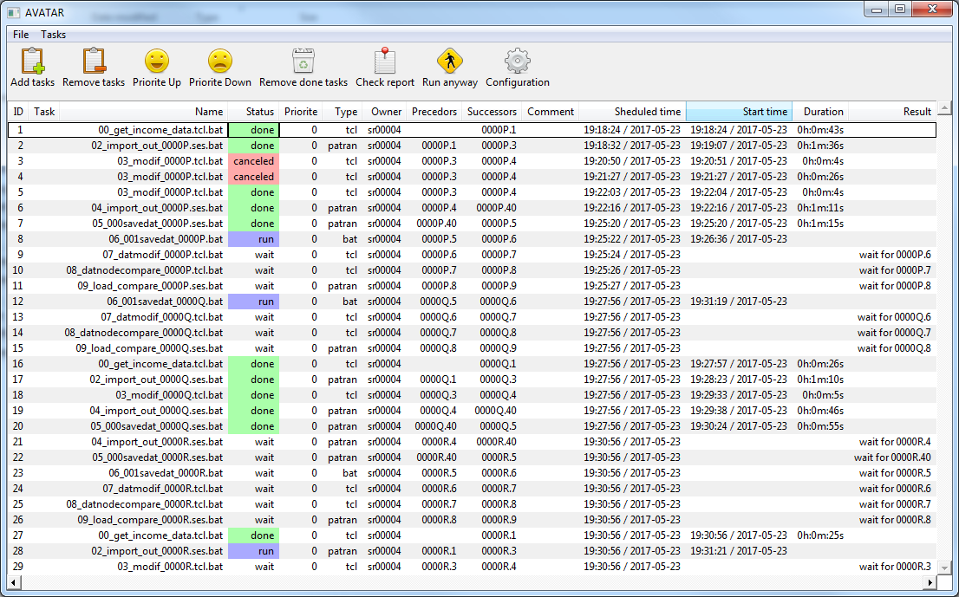
AVATAR
Based on BAT file
IN OUT flags
Limitation of threads, types
Mutex for the files, resources
Logging, alerting, time measurement
TASK MANAGER

Slide 33
3. BINARY
Dealing with large volumes of data (>1e6 elements x 100timesteps x multiple results)
Storage by list or arrays is not possible
Need fast calculation of derived results
Visualization 3d

Slide 34
Binary object
Storage by binary string
Head and data parts
Head can have different types and size
Data represent some uniform storage : single, vector, matrix, indexing, etc
HEAD
DATA
HEAD ALWAYS ( 6 integers):
HEADSIZE, HEADTYPE, DATATYPE, DATASIZE, ACCESS, VERSION
HEAD FOR MATRIX :
+ NUMROW, NUMCOLUMN
DATA TYPES:
DOUBLE, FLOAT, INTEGER, LONG, STRINGS (0 terminated)

Slide 35
COMMANDS
b! vector integer 2000 = x y z ; # creating vectors
b? $x n sizeof min = v1 v2 v3 ; # getting information
b+ $x $y $z : 2000 ; # adding elements
b- $x : 2:300 ; # deleting elements
b< $x : * = 1.0 ; # setting value
b< $x : $is = $y ; # setting from bins
b> $x : 0:10 = list ; # getting
b> $x : $is = *v1 ; # getting to a binary
b>% … ; #formatted output
b<% … ; #formatted input
b~ $x ; # deleting

Slide 36
IsShared?
By default, every access to byte array creates a copy – need to avoid this
Bin is always unique object, accessed from many variables, procedures
Everyone who have this pointer can change its content
Version and access mode INT are reserved in header for future implementation
cc = bin_decrement ((Tcl_Obj*)p);
h = (int*) Tcl_GetByteArrayFromObj((Tcl_Obj*)p, &len);
// no copy!
bin_increment ((Tcl_Obj*)p, cc);
// tcl
set x $y
b< $x : * = 1.0
b> $y : * = values ;

Slide 37
C-POINTER IN STRING REPRESENTATION
During creation, a string representation is added to the object with pointer to Tcl_Obj : *1231451501
All bin commands check – TclType is binary or it’s a string starting with *
For the second option, address of Tcl_Obj is read from a string
thread::send -async $t1 "b.vonm $sx $sy .. $vonm : 1:50000000" result
All bins pass like *123344..
Automation → no user → no problem

Slide 38
THREADING
load bin64.dll
b! vector double 100000000 = sx sy sxy vonm
b! vector double 0 = sz syz sxz vonms
console show
b< $sx : * = 1.0
b< $sy : * = 2.0
b< $sxy : * = -3.0
puts stdout [time {b.vonm $sx $sy $sz $sxy $syz $sxz $vonm $vonms : *} 1]
package require Thread
set t1 [thread::create];
set t2 [thread::create]
thread::send $t1 "load bin64.dll"
thread::send $t2 "load bin64.dll"
puts stdout [time {
thread::send -async $t1 "b.vonm $sx $sy $sz $sxy $syz $sxz $vonm $vonms : 1:50000000; set a 1" result
thread::send -async $t2 "b.vonm $sx $sy $sz $sxy $syz $sxz $vonm $vonms : 50000001:99999999; set a 2" result
for {set i 0} {$i < 2} {incr i} {
vwait result
}
} 1]

Slide 39
THREADING
 | 1xTHREAD | 4xTHREADS
NETTOP, size 100,000,000 | 1,409,823 | 672,834 | -52%
WORKSTATION, size 100,000,000 | 787,609 | 404,442 | -49%
NETTOP, size 100 | 9 | 16,023
All measurements are in microseconds
multithreading cost +16ms
Charge of processor is adequate but not the gain

Slide 40
SPECIAL BINARY OBJECT HASH
Special object hash (as Tcl_Obj)
h! string -1 int 1 = h1 ; # string key, 1-integer value
h! double 1 int 1 = h2 ; # 1-double key, 1-integer value
h< $h2 : $dbls = 1 ; # mark all doubles from vector
h>> $h2 : * = trim ; # get keys

Slide 41
CONCLUSION
TCL & HUMAN LEVEL
C & machine level
1000
Architecture of program
Small data volume
Complex data, complex relations
Flexibility
Rapid evolution
1000000
Large simple data
Speed and volume optimization
Direct data access
Bricks of types, of methods
C
Complexity
flexibility
Volume
speed

Slide 42
QUESTIONS

