Slide 1
HAMMERDB, LOAD TESTING AND BENCHMARKING DATABASES WITH TCL/TK
Steve Shaw July 2017

Slide 2
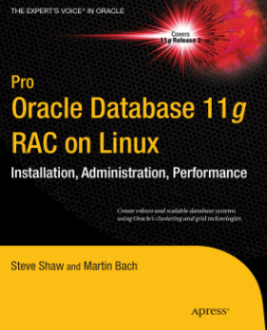
Introduction and why this presentation?
Introduction
Steve Shaw – Database Tech Manager Intel
Co-authored 2 books on Oracle
More Database focus than a developer
HammerDB is an employer approved open source project
First used TCL in Oracle 9i Enterprise Manager
Background
Entry on Tcler’s Wiki by Steve Huntley for HammerDB that said it was successful and well hidden – I wanted to update the entry
Email conversation with Steve Huntley led me to update the Wiki and submit this presentation to EuroTCL

Slide 3
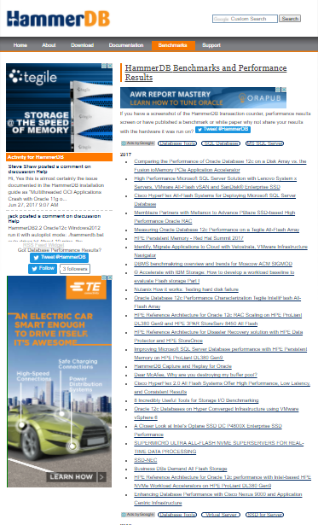
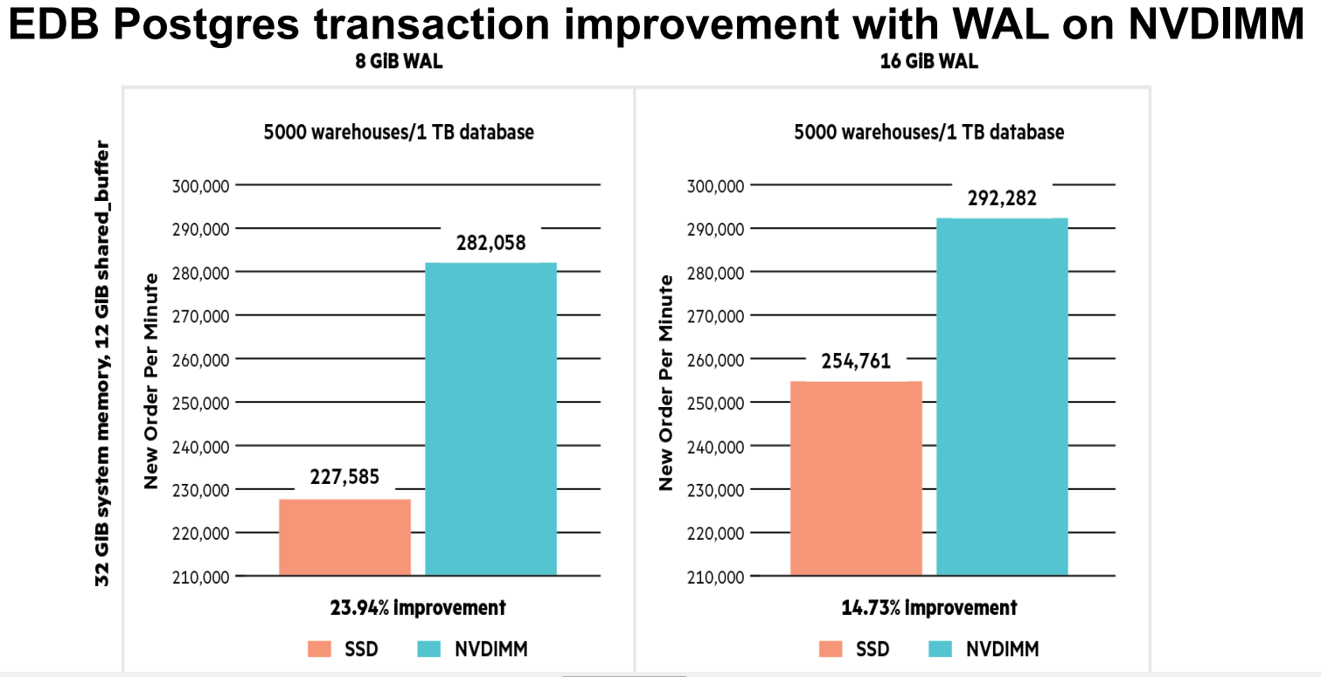
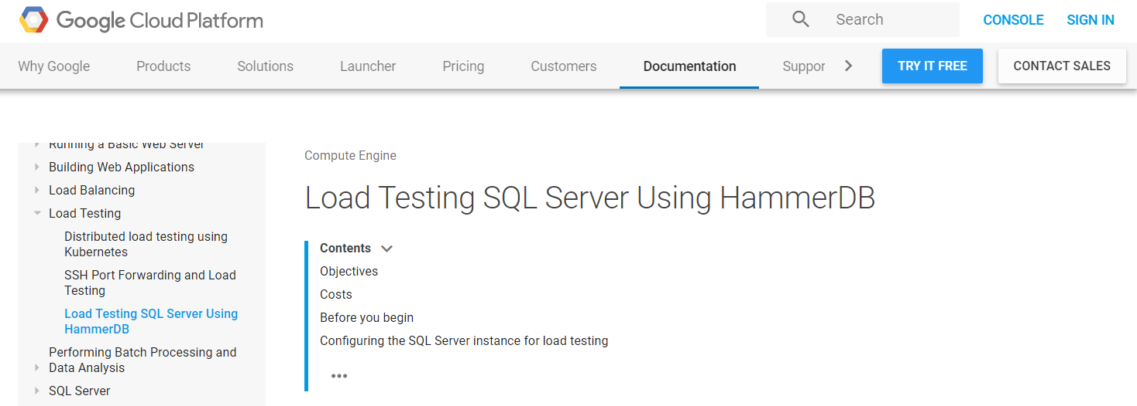
What is HammerDB?
“industry standard database benchmarking tool”*
http://www.hammerdb.com/benchmarks.html

Slide 4
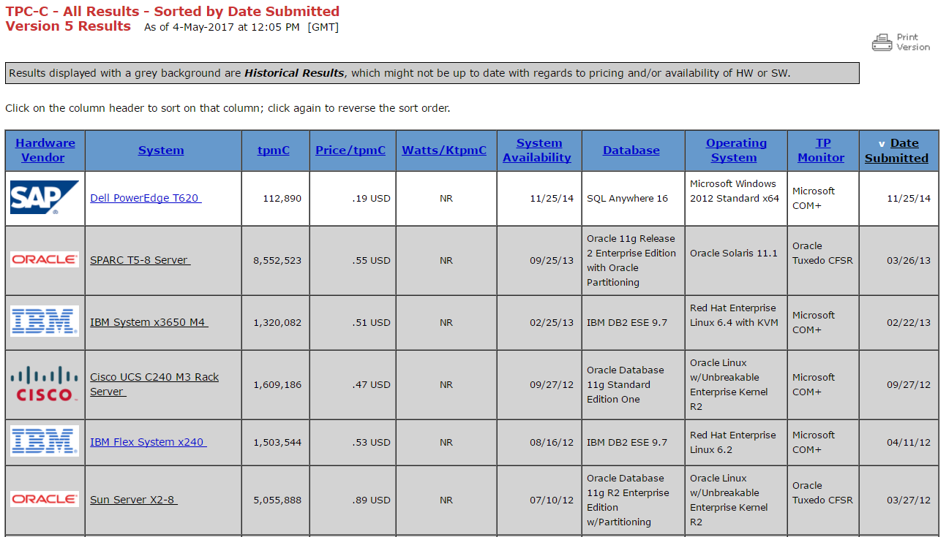
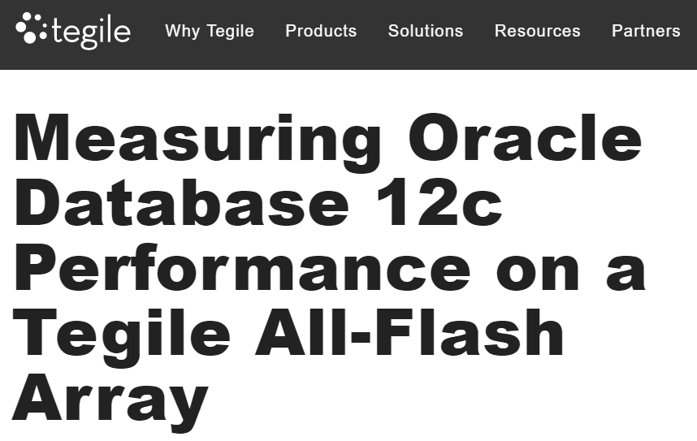
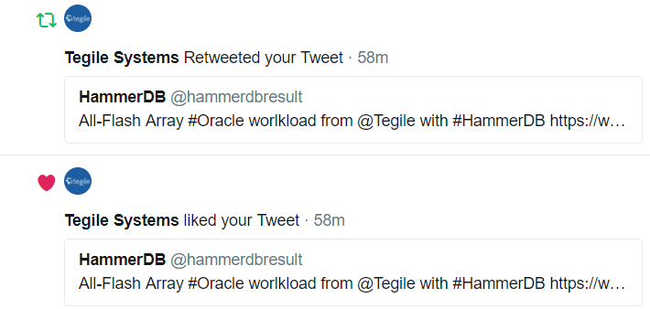
Why HammerDB?
Old method:
Submit official audited benchmarks
Example cost for 1 official benchmark $4,483,729
‘Bare Metal’ environment
Last official TPC-C benchmark in 2014, 1 current
New method:
Enable people to run own benchmarks
Inbuilt OLTP (TPC-C) and OLAP (TPC-H) workloads
Zero Cost
Bare Metal + Cloud, virtualization, containers, control groups
Share your results online

Slide 5
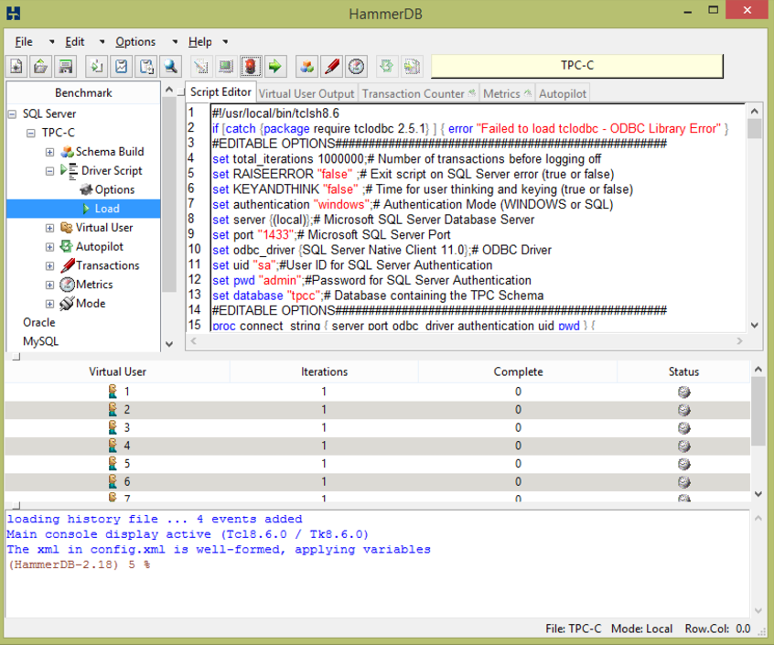
HammerDB from a TCL viewpoint
Sourceforge GPL project open source, precompiled and packaged (installjammer) for Windows and Linux
TK GUI driven configuration using Tile themes
In-built scripts to build and run benchmarks
Script editor in Ctext with highlighting
Script posted to multiple ‘Virtual Users’
Virtual Users are TCL threads
User Output monitored in a tablelist
Errors reported to inbuilt tkcon console

Slide 6
Databases and TCL extensions used
All extensions compiled using gcc on Linux and MS Visual C/C++ on Windows
Third party database libraries are required in the library path
Database | TCL Extension
Oracle/TimesTen | Oratcl
MS SQL Server/Linux and Windows | Debian patch version of TclODBC 2.5.1
IBM DB2 | updated version of db2tclBelinksy to add bind variable support
MariaDB/MySQL/Amazon Aurora | MySQLTcl
PostgreSQL/Greenplum/Amazon Redshift | PgTcl Pgtclng version
Redis | In-built TCL client
Trafodion SQL on Hadoop | TDBC

Slide 7
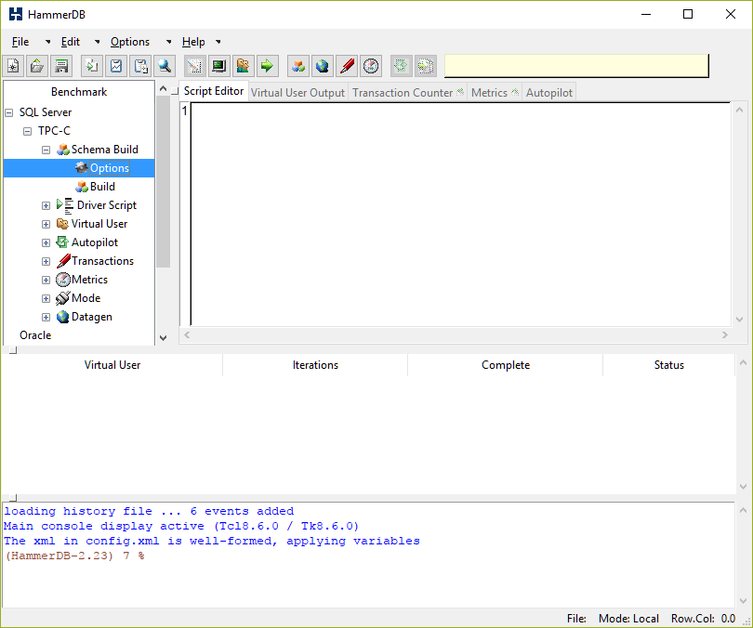
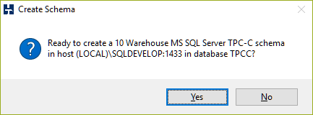
Example Usage SQL Server
Typically set up as client/server
GUI driven options
Select Build from GUI Choose Options Confirm Build

Slide 8
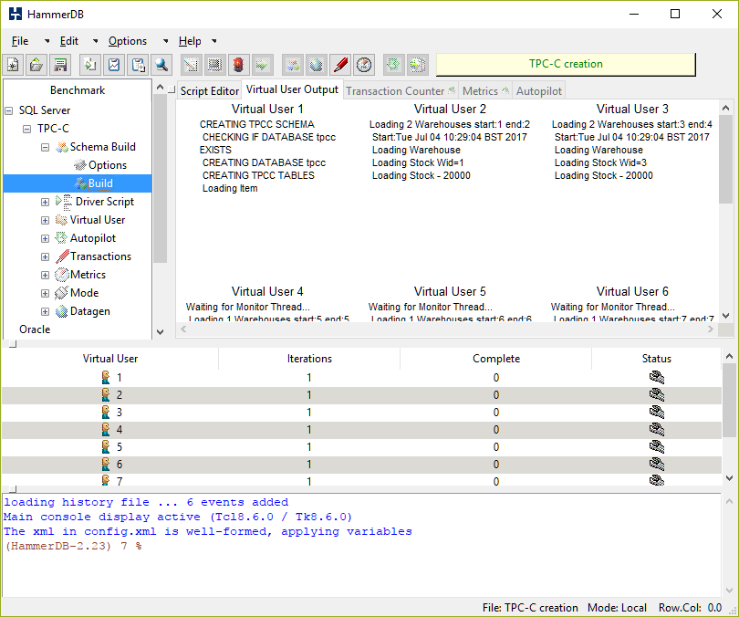
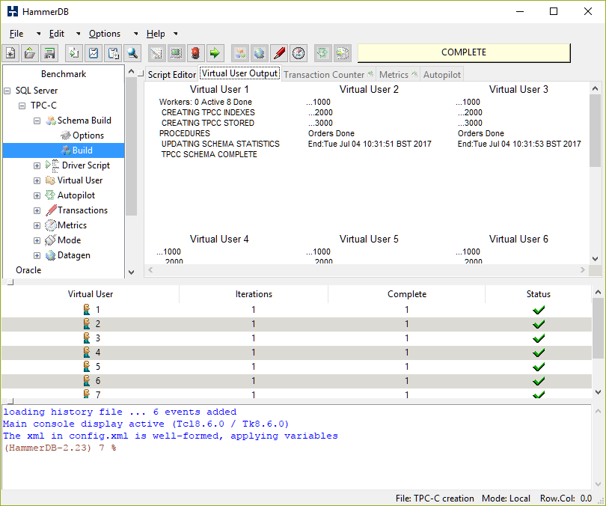
Build Schema
The actions of each thread determined by position
TCL Build Script + T-SQL Multi-Threaded Build Schema Complete

Slide 9
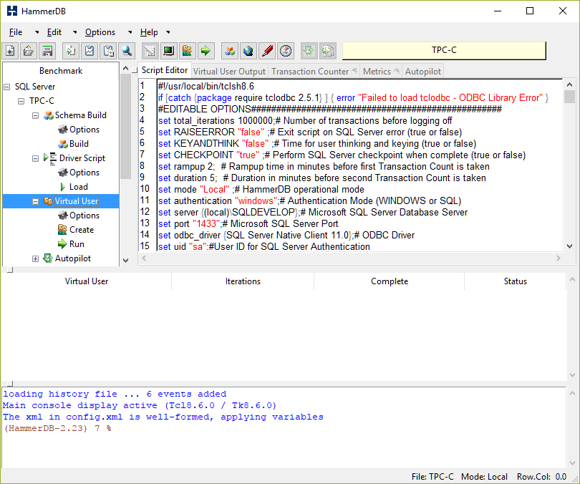
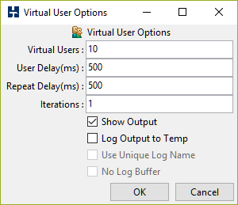
Configure Driver
GUI chosen options loaded into script
Choose Workload Driver Script Virtual Users

Slide 10
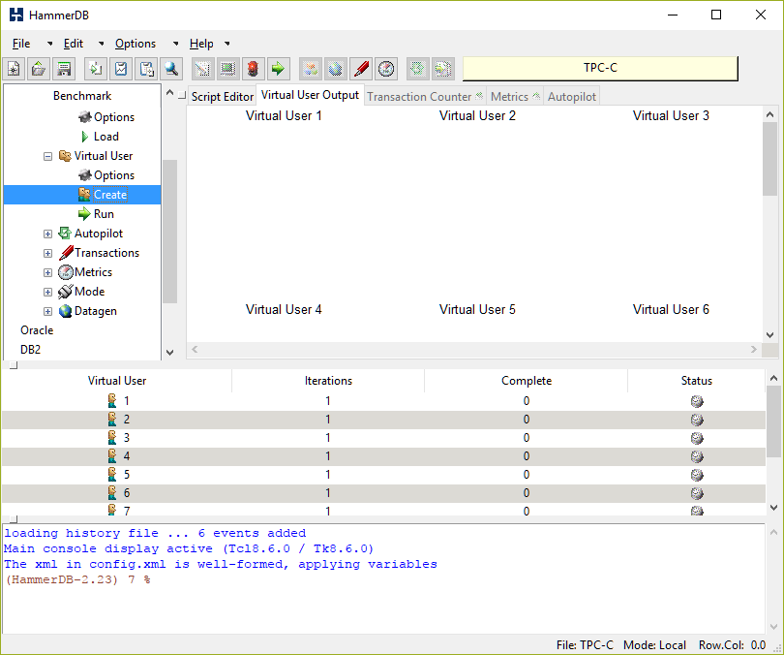
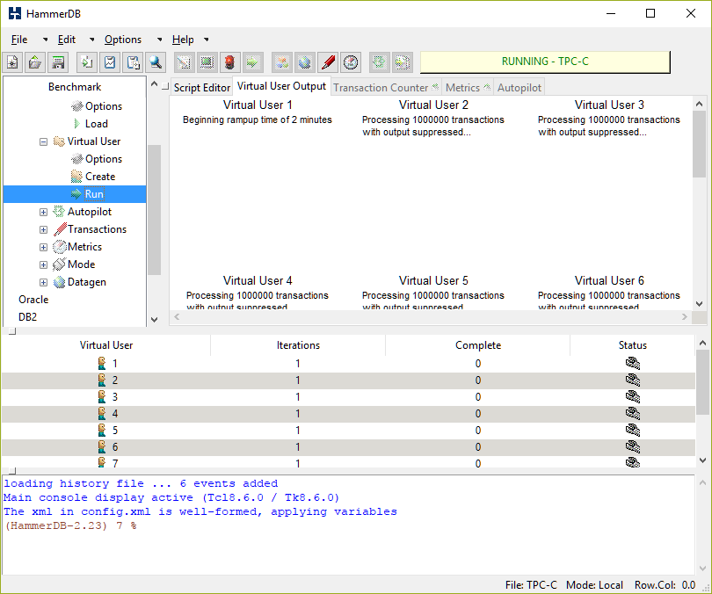
Run Workload
Virtual Users Run the benchmark

Slide 11
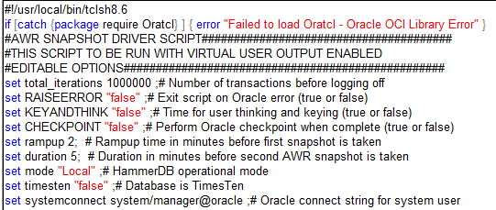
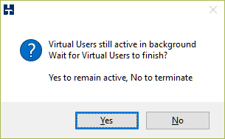
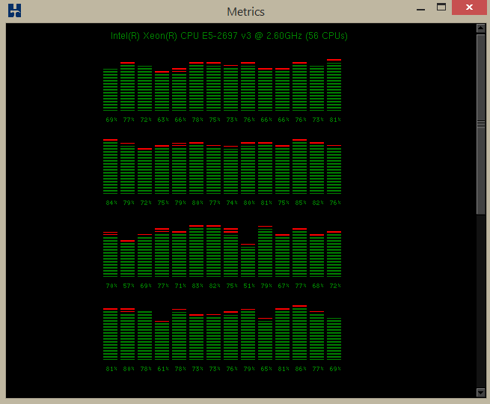
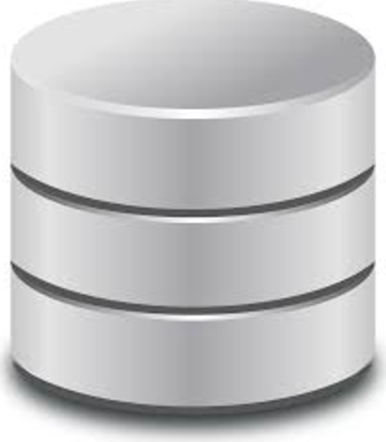
Why TCL for database benchmarking?
TCL Threading Model - User sees 1 process per application
One Interpreter per thread eq High Performance, High Scalability, Stability
Users check a TSV to
See if stop button pressed
or can kill threads
Database driven
To 100%
One thread, 1 interpreter with low level API
Tens of millions
transactions per minute

Slide 12
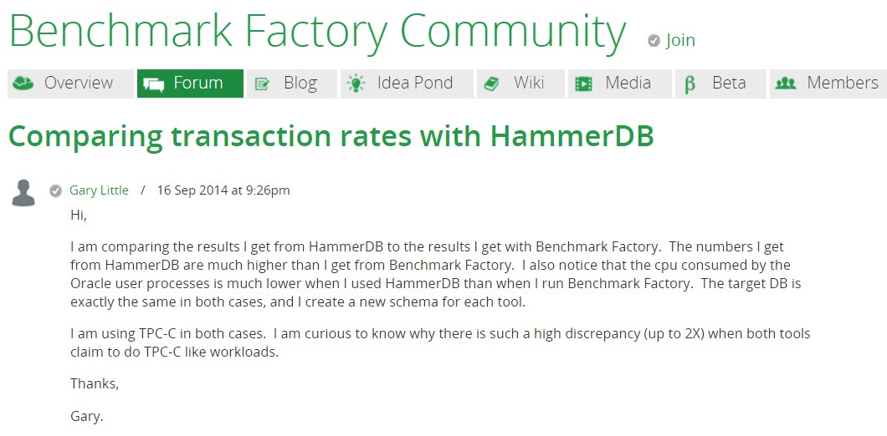
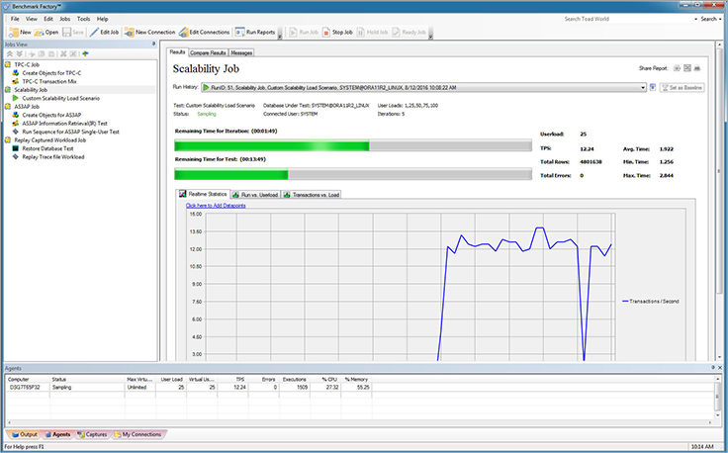
Commercial Comparison
TCL based open source application delivers higher performance at lower CPU utilisation than leading commercial tool

Slide 13
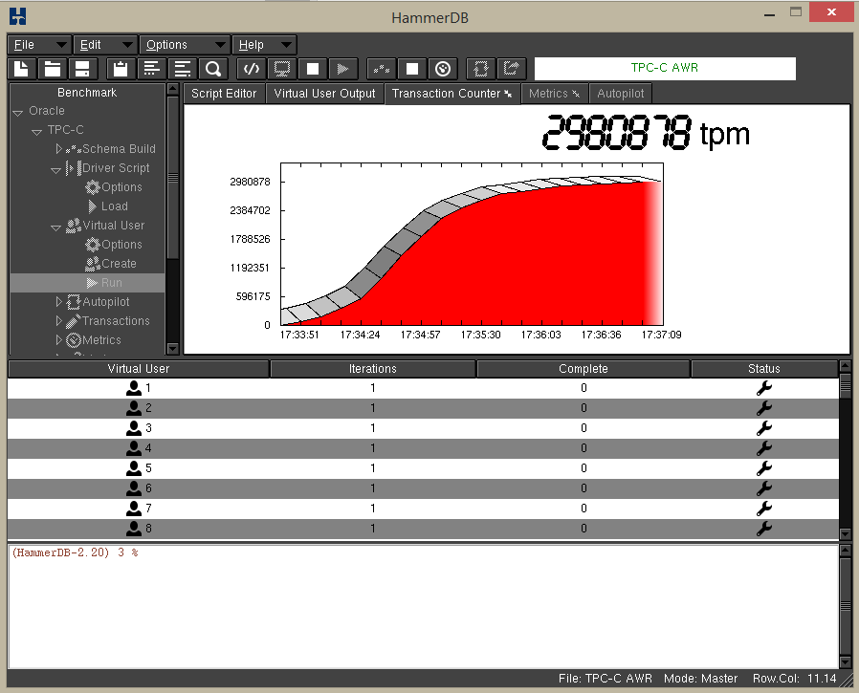
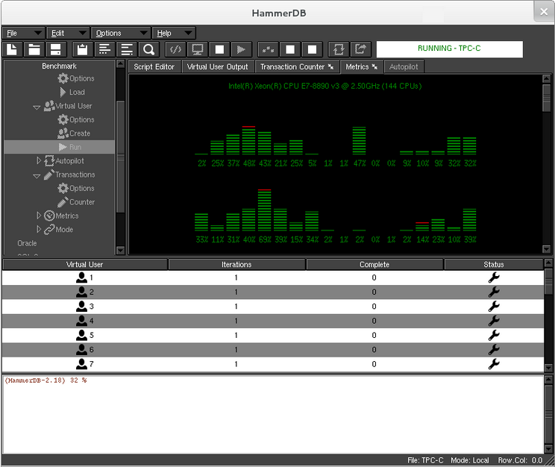
Pure TCL Transaction Counter and CPU Monitor
Separate thread
emu + ribbon graph
Detachable Window
Driven by server side agent running mpstat
On Windows uses TCL mpstat using twapi
Detachable Window

Slide 14
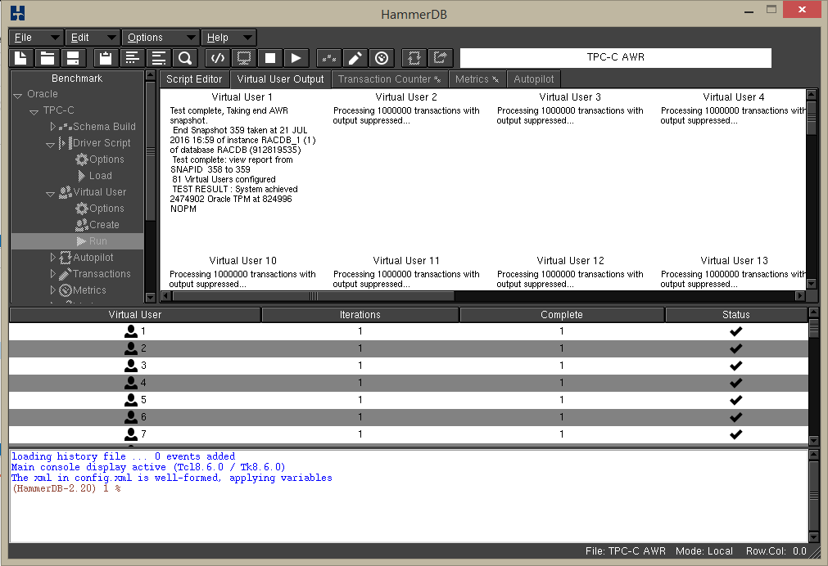
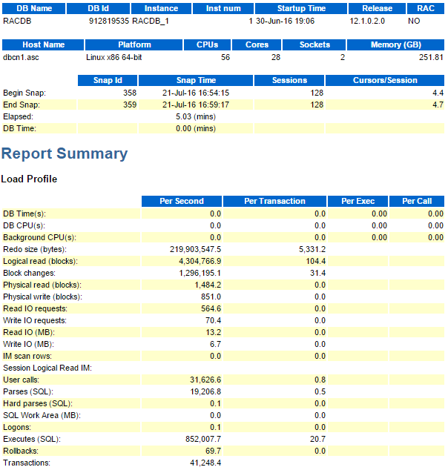
Integrated Database Performance Output and Reports
AWR Report 41,248 per sec * 60 = 2474880 = 2474902 TPM

Slide 15
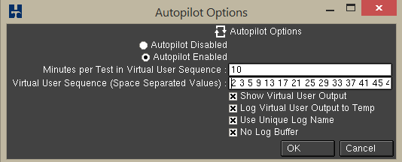
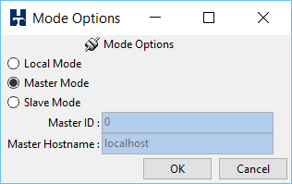
Autopilot and Remote Modes
Timed TK driven button presses for ‘one press’ automated test sequence
Remote Modes comm based connect multiple clients for VM/Cluster testing
Autopilot
Remote Modes

Slide 16
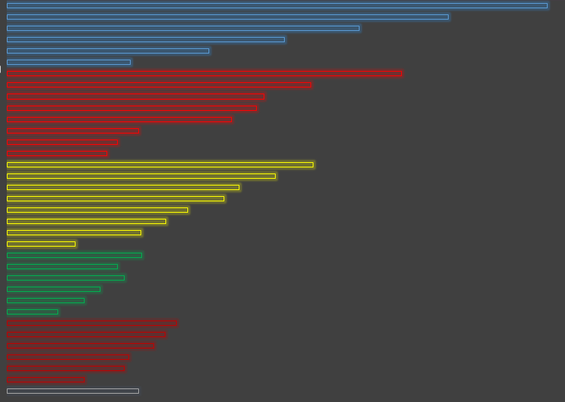
Example use in Intel and partners
Used by the leading Enterprise OEMS eg HPE SQL Server on Linux
Used in Intel database testing in multiple groups
eg Generate database performance data for forthcoming processors
CPUs required to pass multiple performance tests HammerDB is one of these these
Scalability proven alignment over generations with TPC-C at fraction of cost
Example ‘Skylake’ (not in chart!)
Generation of performance data for multiple SKUs
Review and Approval
Known product performance
Not public due to database licensing
Generational Performance Scaling
CPU Generations
TPM

Slide 17
Example Use Externally
Req Id: 76262 Senior Storage Solutions Engineer:
Austin, TX, US
Database benchmarks – HammerDB, SysBench
Technical Marketing Engineer (SC16457)
SUPERMICRO COMPUTER INC, San Jose, CA
Define and develop application benchmarks Key examples include HammerDB
Job ID #: 53651
Position Title: Performance Engineer
Location: CHN-Beijing Application benchmarks and load generation tools (BigBench, HammerDB, etc)
Senior performance engineer
Principled Technologies, Inc. - Durham, NC 27703
HammerDB, or similar benchmark toolsets
*
Senior Testing Eng.
Hexatier - England
Experience with Jmetter, HammerDB or any other database performance tool (huge advantage)
Senior testing engineer
Jerusalem IL
Experience with Jmetter, HammerDB or any other database performance tool
Regional Technical Specialist Oracle.
Hitachi Data Systems Santa Clara, CA, US
o Exposure to standard benchmarking tools (Swingbench, HammerDB, etc.)

Slide 18
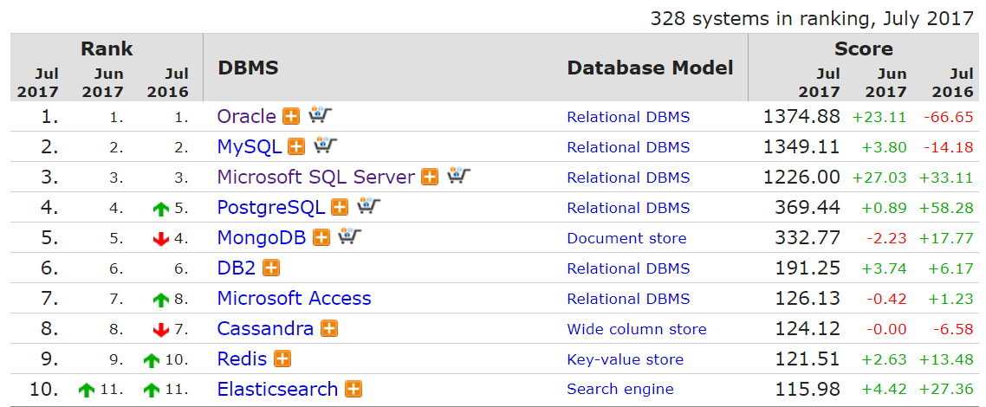
Ongoing Development for v3
HammerDB grew ‘organically’ from an application called Hammerora for Oracle
Now Supports top 5 RDBMS (+2)
Multiple Requests to support additional databases
Refactoring underway to make adding databases easier – 328 listed in DB-Engines
Now XML <-> Dict driven to make
adding databases by XML file and
build and driver scripts
eg requests for SAP HANA, SQLite, Cassandra, MongoDB, Tibero, Cubrid, Linter and TPC-E, TPC-DS

Slide 19
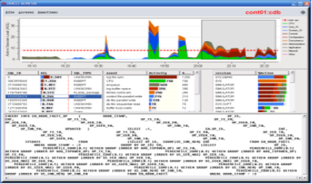
Other planned v3 Development
Updates to latest TCL/TK packages and extensions for precompiled currently 8.6.0 (there is a lot of testing required per database!)
Code Tidying
Number of GUI enhancements and improve some ‘idiosyncrasies’
Transaction Counter Improvements
A lot of scope for C based helper functions eg
random strings
Add to Metrics eg permission from author
to add ASHMON for Oracle currently in TCL/TK 8.4
using BLT
Updates to Documentation for new release – currently fairly extensive as need to detail database connectivity

Slide 20
Questions?

