Slide 1
McFSM – A vast extension to Finite State Machines

Slide 3
Adobe 2008
Some fundamental facts about Software Development are well-known since a very long time.
Current Design of Large Systems
Networks of objects form implicit data structures
Messaging among objects form implicit algorithms
Design Patterns assist in reasoning about these systems (Local rules which approximate correct algorithms and structures)
Iteratively reﬁne until quality is good enough
A "Generic Algorithm" for Creating Large Systems
Identify the components and how they connect and inter-relate
Organize the system into a directed acyclic graph (DAG) Identify the algorithm in any cyclic areas, factor into a separate algorithm and replace that area with a node executing the algorithm
Ensure that for all states of the system a DAG structure is maintained
Describe similar problems as similar structures
Declarative Programming
Describe software in terms of rules rather than sequences of instructions Rules deﬁne a structure upon which solving algorithms can operate
Avoid Turing-complete code, if possible
Facts
1/3 of the code in Adobe’s desktop applications is devoted to event handling logic
1/2 of the bugs reported during a product cycle exist in this code
McFSM is a declarative solution that addresses all these concerns!
Slightly adapted from the Adobe presentation 2008, Sean Parent (Principal Scientist): “A Possible Future of Software Development”
http://stlab.adobe.com/wiki/index.php/Image:2008_07_25_google.pdf
Notes:
In the same presentation are many more interesting points. Among them:
…Writing correct implicit algorithms is very difficult
We need to study what these implicit algorithms do, and express the algorithms explicitly on declared data structures
The situation is so severe, that he emphasizes: “We don’t solve problems, we approximate solutions.”
furthermore
the danger of Turing-complete code is acknowledged
and “Declarative Programming” is proposed as the solution.
The Declarative Programming Solution: Make the machine “understand” as much as possible!

Slide 4
Large Systems
CPS often use networks of messaging objects, implicitly forming global data structures and algorithms.
global view
explicit
Objects
+
Messages
Global
Data structure
+
Algorithms
implicit
local view
McFSM is the explicit, global view onto objects and their interactions!
Notes:
CPS (cyber-physical-systems) are usually modelled using networks of messaging objects to represent the various aspects of the real world.
Having only a limited local view and suffering implicit effects obscures the global structure and its interactions.
To make all this visible, we need to make it explicit
and adopt a global view.
Implicit data structures and implicit algorithms are very hard to understand and even harder to maintain, which makes Large Systems so costly.
Having only a limited local view on the entire system, with its implicit global data structures and algorithms, is at the heart of the problem.
Making the system data structure explicit and inspecting it globally makes an essential difference.
To be useful this global view must focus on the essentials and not let the user get side-tracked to petty details. – In doing just that, you get McFSM as a result.

Slide 5
Advantages and Limits of FSMs
FSMs have no “run-time secrets” (can proof everything at compile-time – no need to resort to incomplete testing)
McFSM
expressive power
FSM
provability
Turing
…⬅languages / machines ➔…
McFSMs create and handle huge(!) FSMs
thereby greatly extending their range of applicability,
while retaining their advantages.
Notes:
Turing-complete code can express everything.
All usual programming languages are Turing-complete.
But they have to rely on testing, because their properties can not be proven at compile-time. (Testing can only show the presence of errors, but never prove their absence!)
FSMs have a limited expressive power, but all their properties can be proven at compile-time:
predictable run-time performance
predictable memory consumption
But they may suffer from “state space explosion”, limiting their application to moderate FSM sizes.
With a FSM the machine can “understand” what is supposed to happen at run-time. – This makes them ideal models.
FSMs usually have excellent performance characteristics, since their implementation usually uses just a single “switch” or a single table-lookup. Therefore FSMs are ideal for real-time applications, the core of operating systems and other applications that need high performance.
In fact most computer programs could be viewed as gigantic FSMs, because their “infinite” structures usually have some finite limits. But as long as we can not exploit this fact by having the ability to reason about these gargantuan state spaces, this view does not advance us any further.
Since McFSMs can import (via Plugin-interface) foreign code and handle huge FSMs, we come close to handling any problem with them. They too may have gargantuan state spaces, but they come with a structure that lets us reason about them!
[There are some efforts to extract compile-time models from Turing-complete code (like C++, Java, C#, …), but this is tedious and giving meaningful feedback to the programmer is not easy, as well.]

Slide 6
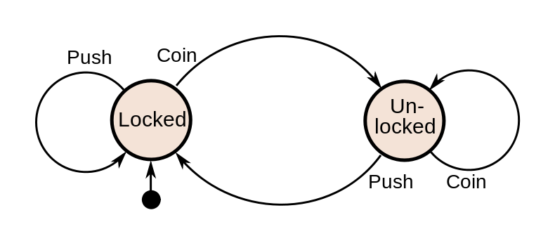
Finite State Machines (FSMs) in the DSL
The McFSM-DSL (domain-specific-language) has a stringent syntax for FSMs.
A turnstile.
FSM class Turnstile {
In: xPush xCoin
States: locked unlocked
hop locked_locked += xPush
hop locked_unlocked += xCoin
hop unlocked_locked += xPush
hop unlocked_unlocked += xCoin
}
DSL conventions:
„states“ -- lowercase:{locked unlocked}
„transitions“ -- underscore: ${from}_$to
„input-events“ -- “x$uppercase”: {xPush xCoin}
„output-events“ -- “y$uppercase”: {yUnlocked}
Bear in mind: FSMs are a “theoretical construct” => they may be huge!
Notes:
The “FSM class Turnstile…” code shows how the turnstile looks in the McFSM DSL (domain-specific-language).
The function hop constructs the transitions and associates input- or output-events with them.
In literature the result created is denoted as delta, “δ : Q × Σ → Q”, which does not consider output-events or the mediator XQueue.
FSMs can easily have millions of states. As we will see later, with McFSMs can even handle FSMs that have more states then universe has atoms. (The universe has less then 10¹⁰⁰ protons.)

Slide 7
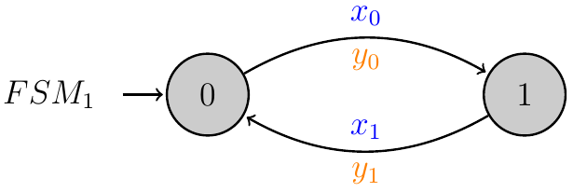
McFSM’s graphical notation for FSMs
input-events above edge (external or internal)
output-events below edge
name
indicate
start-node
Notes:
As usual each edge has input events, which help to decide upon which edge to follow and like in Mealy machines each edge also has output events, which get generated when an edge is traversed.
From the perspective of a single FSM both internal and external events are input-events. The different colorings lets us see couplings more easily.

Slide 8
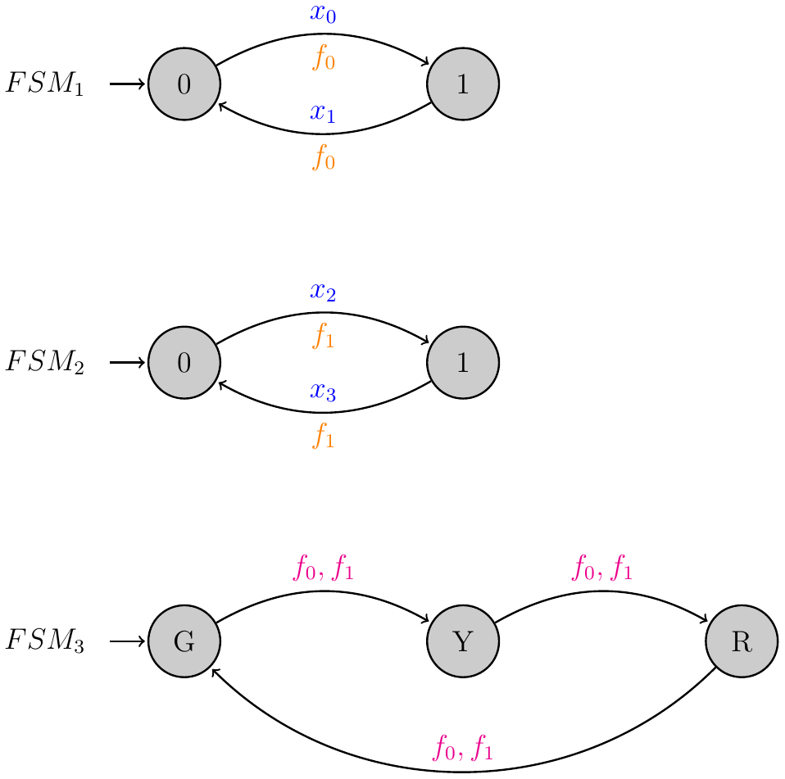
McFSM = Multiple coupled Finite State Machines
McFSMs couple FSMs via internal events, that is, their state transitions.
FSM₁, FSM₂ represent “switches”: 0=up, 1=down; FSM₃ represents a “status indicator”: G=green,Y=yellow,R=red;
FSM₁, FSM₂ react on external events x₀, x₁, x₂, x₃
and publish their output events f₀, f₁.
FSM₃ subscribes and reacts to these f₀, f₁ (PubSub Design Pattern), making them internal.
Notes:
FSM₃ the “status indicator” subscribes to the output events of the switches FSM₁, FSM₂ and by doing so, makes them into what we call internal-events.
The DSL follows here the PubSub Design Pattern, loosely coupling the subscribers to the publishers.
The comma in „f₀,f₁“ means „OR“.

Slide 9
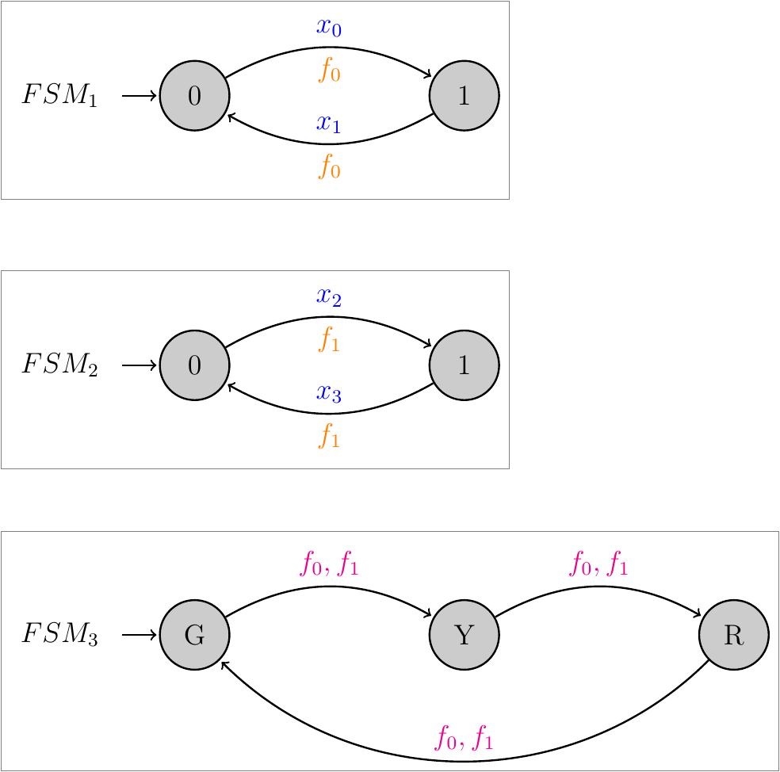
McFSM = Multiple coupled Finite State Machines
If we view FSMs as opaque entities

Slide 10
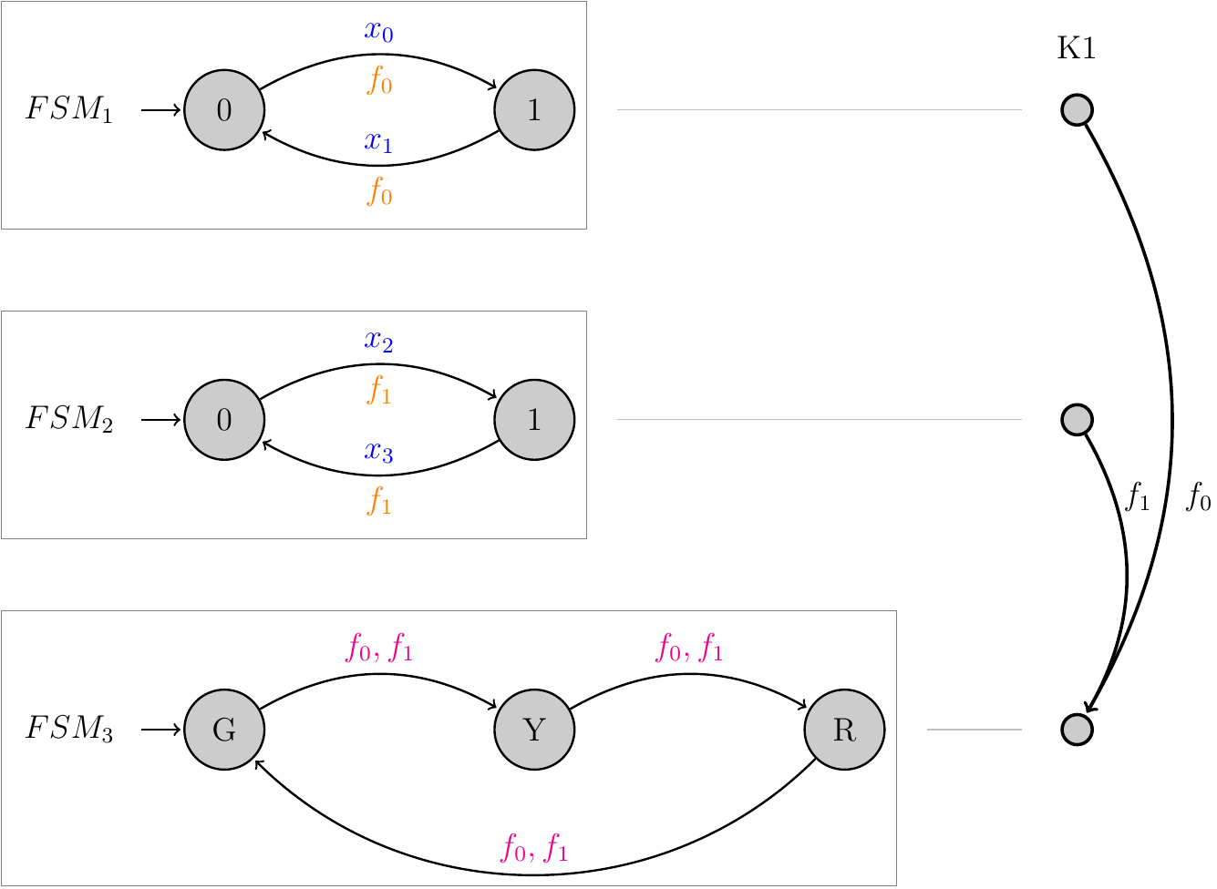
McFSM = Multiple coupled Finite State Machines
If we view FSMs as opaque entities and draw their “connections”
we get “K1” (a condensed graph)
allowing us to do some “reasoning”:
if “K1” is cycle-free, then the McFSM is “well-defined”.

Slide 11
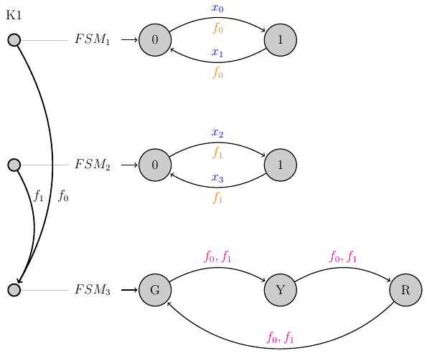
K1, K2, K3 = Condensed Automata
To analyze a McFSM we can use “condensed“ versions depicting interdependencies of FSMs.
“K1” is a non-deterministic automaton representing each FSM with a single node and connecting two nodes iff the first FSM has a “topic” which the second one “observes”.
“K2” is similar but more sophisticated.
“K3” is provided by the plugin-interface.
Cycle-freeness of K1 or K2 is sufficient to establish well-definedness of the McFSM.
This is an easy way for the IDE to establish correctness, or warn the user.
Notes:
Finding other conditions that are sufficient and finding conditions that are necessary for well-definedness is on-going research.

Slide 12
McFSM : FSM = Recursive : Nonrecursive
McFSM and Recursive-Functions have the same construction and semantics!
Events can be viewed as method calls of FSM objects: fsm.δ(evt);
void f() {
g();
h();
i();
}
Recursive Function
McFSM
f() triggers sequence of internal calls g(), h(), i()
recursive: g(), h(), i() may call f() again
preserve order: g() before h(), before i()
run-to-completion: finish g() before starting h(), …
event e₀ triggers sequence of internal events e₁, e₂, e₃
recursive: e₁, e₂, e₃ may call fsm.δ() again
preserve order: e₁ before e₂, before e₃
run-to-completion: finish e₁ before starting e₂, …
preserve-order + run-to-completion => we need a stack! (XQueue)
Notes:
The relation between McFSM and FSM is the same relation like we have it between Recursive and Nonrecursive functions.
Recognizing this kinship to Recursive-Functions gives a clear cut path to the coupling semantics: Use a stack as internal mediator of events! (it is called “XQueue” = extended queue for historical reasons and because it carries additional structure, like the information on event-ordering)
This very insight distinguishes McFSM from seemingly similar approaches and by this McFSMs carry the power of Recursive-Functions into the realm of FSMs.

Slide 13
IDE for McFSMs: “McGen”
Html-Doku
DSL
Tk-UI
Html5-UI
Parser
McGen
Webserver (Websockets)
(WebServer)
Generator
C
C++
go
JavaScript
Java
Lua
Protobuf
Python
Tcl
…
Notes:
SQLite shows the internal data-structures before and after internal processing, thus making it easy to extend the IDE using any programming language.
DSL := Domain specific language.
Not-yet:
Html5-UI
Bidirectional arrows “DSL⬄SQLite⬄UI”

Slide 14
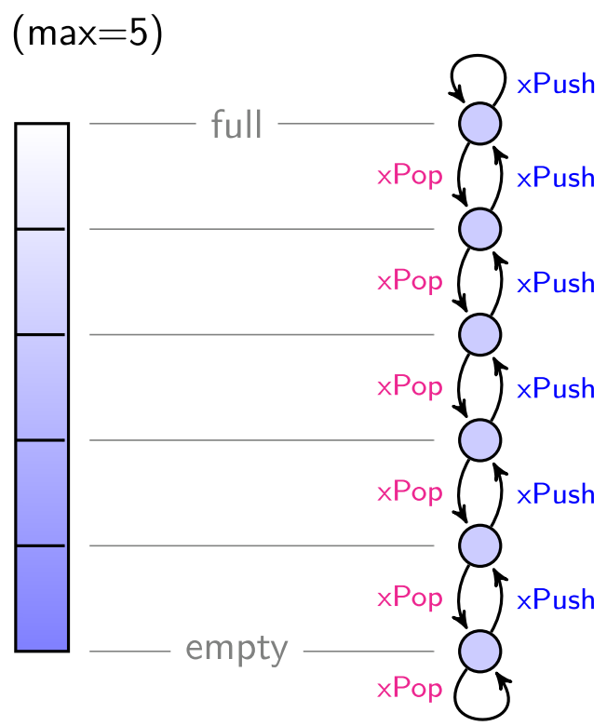
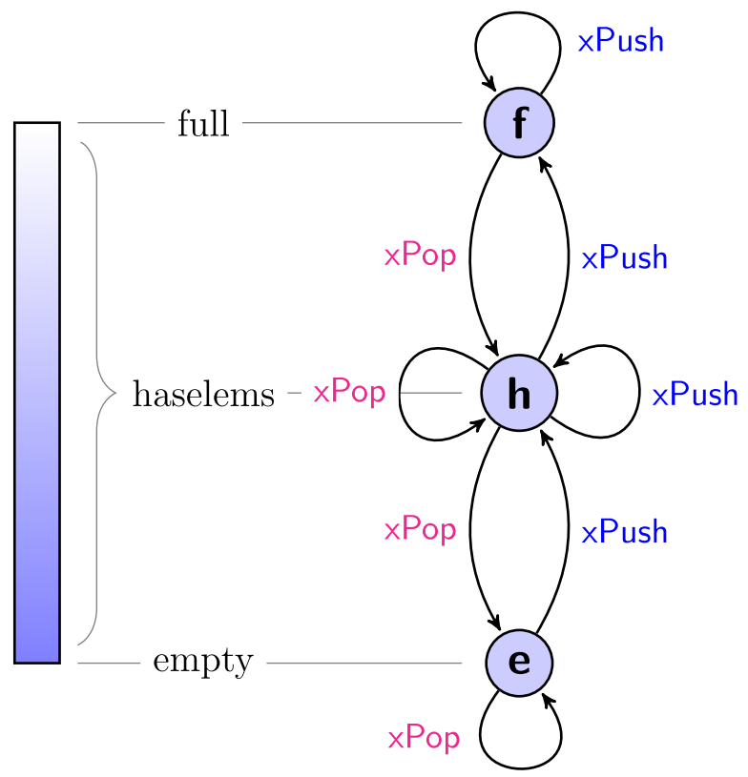
„FiniteStack“ - a generic data structure as FSM!
Most data structures, like „Stack“, can be transformed into FSMs using “max” and “min”.
Sample „FiniteStack“ – (some Input-Events):
K3
… More “Input”/
“Notification”-Events:
Modifying:
xPush(evt)
xPop()
Read-only:
xTop()
xCount()
xIsFull()
xIsEmpty()
…
instance
class
memo: y=f(x);
Notes:
The class automaton K3 is non-deterministic (a “NFA”) – otherwise everything in McFSM is deterministic!

Slide 15
„FiniteStack“ - a generic data structure as FSM!
Most data structures, like „Stack“, can be transformed into FSMs using “max” and “min”.
Sample „FiniteStack“:
instance
memo: y=f(x);
Notes:
The class automaton K3 is non-deterministic (a “NFA”) – otherwise everything in McFSM is deterministic!

Slide 16
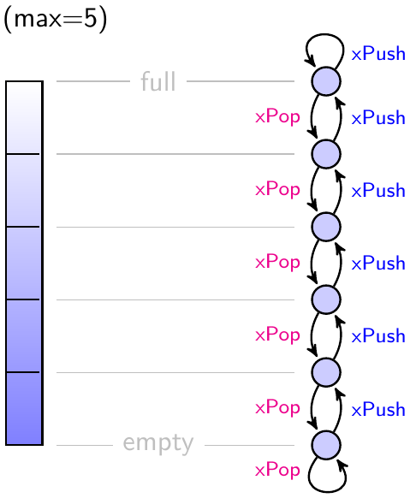
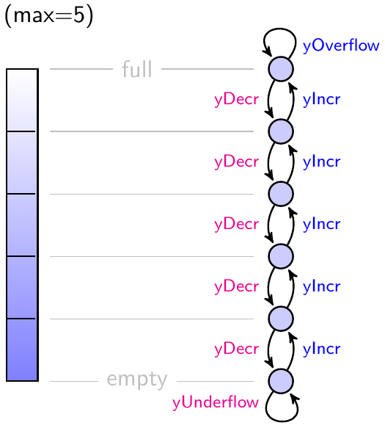
„FiniteStack“ - a generic data structure as FSM!
Via the Plugin-interface we get to know the finite-state structure at compile-time.
Sample „FiniteStack“:
input-events
output-events
memo: y=f(x);
Notes:
Notice, that “yOverflow” and “yUnderflow” are just events, not exceptions!
To handle them as exceptions (or not) is the responsibility of other software layers – not the McFSM’s.
Or, you may add a FSM that collects “exceptional” events like that and indicates by its state an “error-state”.

Slide 17
„FiniteStack“ - a generic data structure as FSM!
The Plugin interface captures the “class-information” to do compile-time reasoning, too.
Sample „FiniteStack“:
K3
=>
instance
class
(Output-events are handled likewise => we can do the usual McFSM-event-coupling.)
Notes:
The class automaton K3 is non-deterministic (a “NFA”) – otherwise everything in McFSM is deterministic!

Slide 18
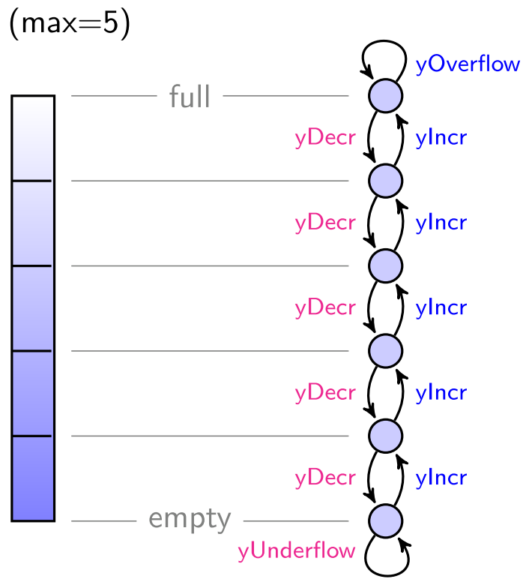
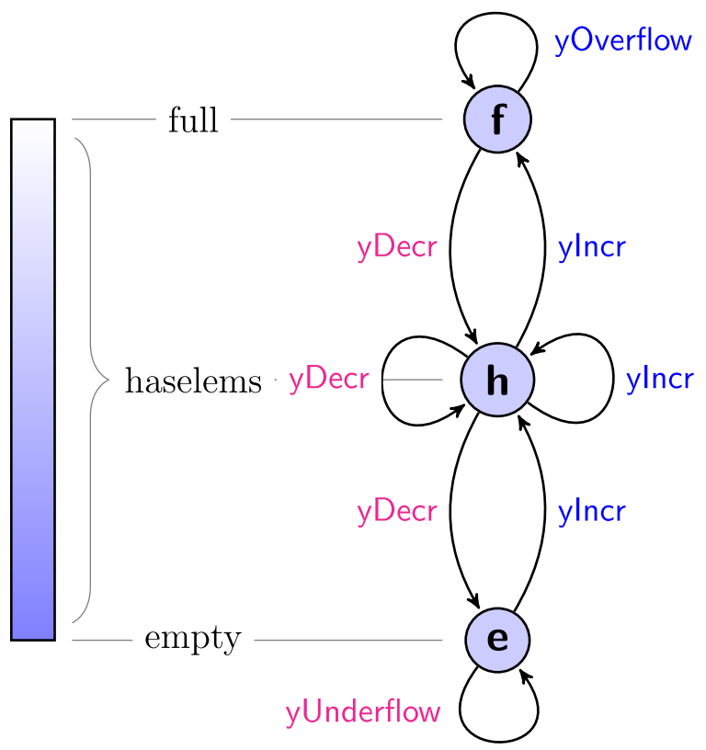
„FiniteStack“ - a generic data structure as FSM!
“Output-Events” enable the usual McFSM event-coupling.
Sample „FiniteStack“ – (some Output-Events):
K3
instance
class
memo: y=f(x);
Notes:
Notice, that “yOverflow” and “yUnderflow” are just events, not exceptions!
To handle them as exceptions (or not) is the responsibility of other software layers – not the McFSM’s.
Or, you may add a FSM that collects “exceptional” events like that and indicates by its state an “error-state”.

Slide 19
Plugin: Generic data structures as FSMs
Any data structure („Stack“, „Queue“, „Prio-Queue“, …) can be made finite to use in McFSM as a FSM!
The compiler knows everything to reason about at compile-time!
the class-automaton
the instance-automata
all instance input-events
all interconnections
the order of FSMs
the order of “internal”-events
reachability assertions
max-number of steps
Every single event, internal or external, is processed strictly deterministically!
The “XQueue” ensures determinism – like the “call-stack” does for recursive functions.
Only the order of “external”-events comes at run-time.
All “internal”-events have a strictly deterministic order via “XQueue”!
We can use “FiniteStack” like any other FSM in McFSM!
The plug-in interface gets enough information to build the small compile-time automata and enables the IDE to reason about potentially huge FSMs like “FiniteStack”.
Notes:
What is shown here for the „Stack“ can be done with almost any data-structure: queues, priority-queues, trees, … - you name it! (Are there exceptions?)
One needs to make it “finite” and program the Tcl-”IFSM”-plugin-interface containing the code-generators, then it is “plugged-in” into the IDE.
Via the “Plugin-interface” the implementation of FSMs can be done in any way we like, but it is a contract to the IDE we sign and have to keep.

Slide 20
Plugin-interface
Any data structure („Stack“, „Queue“, „Prio-Queue“, …) can be made finite to use in McFSM as a FSM!
The compiler gets to know everything to reason about at compile-time!
We can use “FiniteStack” like any other FSM in McFSM!
Notes:
What is shown here for the „Stack“ can be done with almost any data-structure: queues, priority-queues, trees, … - you name it! (What are the exceptions?)
One needs to make it “finite” and program the Tcl-”IFSM”-plugin-interface containing the code-generators, then it is “plugged-in” into the IDE.
Via the “Plugin-interface” the implementation of FSMs can be done in any way we like, but it is a contract to the IDE we sign and have to keep.

Slide 21
Current implementation
.
The generated code
can stand alone, it does not need any library or other infrastructure
can use the language of your choice
is very efficient
its maximum number of steps can be assessed at compile-time
good for real-time applications
SQLite shows internal data and results: allows post-processing / extensions.
Notes:
The generated code can use “enums” (i.e. integers), which have the same value across all generated programming languages. This allows very efficient communication, especially when combined with protocols like “Google-protocol-buffers”. (We plan to generate protobuf messages in the near future, too.)

Slide 22
Future steps
Find Business Units interested in compile-time provably correct software, that is McFSM.
Make McFSM IDE public domain.
Further develop the Theory of McFSMs.
How have proofs to be adapted when dealing with McFSMs?
How have proofs to be adapted when plugin structures are involved?
Extend the DSL
Invent a “requirement language” to define properties that the user wants to be true. (assertions, reachability, etc.)
Implement automatic compile-time proofs of these user-requirements.
Extend the Code-generators
generate messages suitable for distributed communication (Google-protocol buffers)
make the generated code thread-safe
Allow the specification of “Distributed Systems”, that is asynchronous communication
Tackle Parallelism, that is enable the user to define new parallelization primitives via McFSM (globally sound!)
Improve the IDE
Notes:
(https://de.wikipedia.org/wiki/Thomas_S._Kuhn) ... a new theory, however special its range of application, is seldom or never just an increment to what is already known. Its assimilation requires the reconstruction of prior theory and the reevaluation of prior fact, an intrinsically revolutionary process that is seldom completed by a single man and never overnight. - Thomas Kuhn.
McFSMs do not directly target concurrency problems, but may be used to tackle them. Other approaches that directly target concurrency loose the purity of the FSM approach, the broader applicability to non-concurrent problems and the aspect of “recursiveness”.

Slide 23
Conclusion
"Perfection is achieved, not when there is nothing more to add, but when there is nothing left to take away." – Antoine de Saint Exupéry
McFSM is a simple and powerful tool to model global system structures.
What distinguishes McFSM from other approaches:
Concise thought-model: “Combine FSMs and PubSub!“
Carries the power of Recursive Functions into the realm of FSMs (XQueue).
Simplicity leads to a theory allowing mathematical proofs.
Extends FSMs to make huge state spaces tractable.
Any data-structure can become a FSM in a McFSM (Plugin interface).
Lean DSL emphasizing PubSub and the Recursive Function view.
Notes:
In my opinion, you can not get any smaller (more concise) when modeling objects and their interconnections!
The McFSM-Plugin-concept is extremely powerful, extending the concept of participating FSMs to every data-structure that can be viewed as finite – which is close to every data-structure.
The DSL (domain-specific-language) is still under active development emphasizing PubSub and the Recursive Function view.
Others seem to have missed out the McFSM idea, because the terms “event” or “signal” led them to jump from simple (non-recursive) FSMs to asynchronously message-coupled FSMs, bypassing the recursive stack-based McFSM-coupling. –
McFSMs handle asynchronicity only with regard to external input-events. These reflect run-time behavior and are therefore unordered anyway. (Modeling “Distributed Systems” within the current McFSM IDE is not-yet possible, although each McFSM might be part of such a system.)
McFMSs are a cross-bread between Observer, PubSub, Message-queue (XQueue!) and Mealy-machines, but confining themselves to the bare-bones essentials of crisscross communication. – This makes them so simple and so powerful!

Slide 24
Thank you for your attention!
Contact information
Florian Murr Senior Engineer Siemens AG / Munich / CT RDA ITP SES-DE
Otto-Hahn-Ring 6
81739 München
Germany
E-mail: florian.murr@siemens.com

Slide 25
The “Observer” Software Design Pattern
The Observer Pattern is still the prevalent pattern to deal with state change.
The pattern:
An object A (the subject) maintains a list of dependent objects (the observers) {B₁ , B₂ , . . . , B_{n} } and notiﬁes them when any state change takes place in object A.
Four major challenges:
it promotes side-effects since state information is only implicitly available. Using such information by multiple observers without violating information encapsulation principles is hard.
observers can execute arbitrary Turing-complete code which can easily lead to violating the principle of separation of concerns.
impossible to statically analyze and understand the dynamic control ﬂow when chains of dynamically registered observers are used.
any state change apart from the one in subject A triggering the notiﬁcations is not part of the observer pattern and is therefore “invisible” from its point of view.
Basing the model of a system on the Observer Pattern is problematic!
Notes:
Note, that “notify()” usually does not have any parameters (apart from the sender) and changing that by attaching change-information entails many difficulties! – This does already indicate, that the Observer-Pattern is sensitive to tiny modifications, making it fragile and hard to use correctly.
And, although Observer deals with “state-change” of the subject, the states themselves and their transitions are absent from the pattern – not to mention states and state-changes in the observers. (Bringing them back in directly leads to McFSM)
Especially “notification-cycles” are evil!
One subject notifies some observers, which are themselves subjects and notify (other) observers. This may have repercussions to the first subject. Code containing such cycles of notifications gets incomprehensible and extremely hard to maintain!
Even finding out whether such cycles might exist, without support, is a hard and tedious job that therefore many never undertake.
“Deprecating the Observer Pattern with Scala.React” by Ingo Maier, Martin Odersky in
http://infoscience.epfl.ch/record/176887/files/DeprecatingObservers2012.pdf
shows many more problems inherent in the “Observer-Pattern” and offers a different solution.

Slide 26
The “Observer” Software Design Pattern
The Observer Pattern is still the prevalent pattern to deal with state change.
The pattern:
An object A (the subject) maintains a list of dependent objects (the observers) {B₁ , B₂ , . . . , B_{n} } and notiﬁes them when any state change takes place in object A.
Some major pitfalls:
state information is only implicitly available. (promotes side-effects)
impossible to statically analyze (Turing-complete code)
observers are not seen as potential subjects (state-less)
…(many more)
Basing the model of a system on the Observer Pattern is problematic!
Notes:
Note, that “notify()” usually does not have any parameters (apart from the sender) and changing that by attaching change-information entails many difficulties! – This does already indicate, that the Observer-Pattern is sensitive to tiny modifications, making it fragile and hard to use correctly.
And, although Observer deals with “state-change” of the subject, the states themselves and their transitions are absent from the pattern – not to mention states and state-changes in the observers. (Bringing them back in directly leads to McFSM)
Especially “notification-cycles” are evil!
One subject notifies some observers, which are themselves subjects and notify (other) observers. This may have repercussions to the first subject. Code containing such cycles of notifications gets incomprehensible and extremely hard to maintain!
Even finding out whether such cycles might exist, without support, is a hard and tedious job that therefore many never undertake.
“Deprecating the Observer Pattern with Scala.React” by Ingo Maier, Martin Odersky in
http://infoscience.epfl.ch/record/176887/files/DeprecatingObservers2012.pdf
shows many more problems inherent in the “Observer-Pattern” and offers a different solution.

Slide 27
The “Publish-Subscribe” Software Design Pattern
The “PubSub” Pattern is closely related to the Observer Pattern but has different intentions.
The pattern:
Objects A₁, A₂, …, A_{m} (the publishers) send messages concerning certain topics to some middleware. The objects {B₁ , B₂ , . . . , B_{n} } (the subscribers) subscribe to some topics at the middleware and get the messages from it concerning these topics.
Differences to “Observer”:
“Subscribers” subscribe to “topics” (not “any-state-change”)
“Publishers” are loosely coupled to the subscribers. They do not have to know even of their existence.
“Middleware” (like “message brokers” or “event bus”, …) ensures the scalability.
PubSub is more common in distributed systems.
PubSub is much less likely to suffer “notification-cycles”.
Note: People used to call both patterns “Observer” and mix their properties and intentions.
PubSub behaves better then Observer (iff not confused with Observer)
Notes:
Being “topic-based” gives a much finer granularity and mitigates the problems of parameterless notify(), that is of state-information being implicit.
(There are “content-based” PubSub-Patterns as well: The Publisher classifies the messages according to content. But this does not make any difference to our discussion here.)
The Observer-Pattern by contrast is “tightly coupled”.
Wikipedia: …Provides the opportunity for better scalability than traditional client–server, through parallel operation, message caching, tree-based or network-based routing, etc….
See also “message queue”: …Message queues provide an asynchronous communications protocol, meaning that the sender and receiver of the message do not need to interact with the message queue at the same time. Messages placed onto the queue are stored until the recipient retrieves them…

Slide 28
The “Publish-Subscribe” Software Design Pattern
The “PubSub” Pattern is closely related to the Observer Pattern but has different intentions.
The pattern:
Objects A₁, A₂, …, A_{m} (the publishers) send messages concerning certain topics to some middleware. The objects {B₁ , B₂ , . . . , B_{n} } (the subscribers) subscribe to some topics at the middleware and get the messages from it concerning these topics.
Differences to “Observer”:
“Subscribers” subscribe to “topics” (not “any-state-change”)
“Publishers” are loosely coupled to the subscribers. They do not have to know even of their existence.
PubSub is much less likely to suffer “notification-cycles”.
Note: People used to call both patterns “Observer” and mix their properties and intentions.
PubSub behaves better then Observer (iff not confused with Observer)
Notes:
Being “topic-based” gives a much finer granularity and mitigates the problems of parameterless notify(), that is of state-information being implicit.
(There are “content-based” PubSub-Patterns as well: The Publisher classifies the messages according to content. But this does not make any difference to our discussion here.)
The Observer-Pattern by contrast is “tightly coupled”.
Wikipedia: …Provides the opportunity for better scalability than traditional client–server, through parallel operation, message caching, tree-based or network-based routing, etc….
See also “message queue”: …Message queues provide an asynchronous communications protocol, meaning that the sender and receiver of the message do not need to interact with the message queue at the same time. Messages placed onto the queue are stored until the recipient retrieves them…

Slide 29
McFSM = Recursive Finite State Machines
Going from “FSM to McFSM” is similar to the step from “Functions to Recursive Functions”.
Recursive Functions | McFSM – (the orange and magenta connection)
void f() { g(); h(); i(); } | void McFSM::handleEvt(XQueue& xq,Event e) { foreach fsm in getFSMsInterestedIn(e) { fsm.handleEvt(xq,e); } }
 | Recursive Functions | McFSM
recursive | any of the functions g(), h(), i() may implicitly or explicitly call f() again. | any fsm.handleEvt(..) may trigger an event in any other FSM again.
keep event-order | g(), h(), i() have to be called in this specific order. | the “fsm” have to be called in a fixed (event-dependent) order.
run-to-completion | all effects of g() have to take place before h() is called and all effects of h() have to take place before i() is called. | all internal coupling-events of the event have to take place before the next event is taken from the XQueue.
stack of queues | the queue {g(), h(), i()} gets on top, replacing f(). Each of these functions gets in turn replaced by its own elements – thus forming a stack of queues. | put the event-sequence on top and replace each element after transition with the sequence of internal coupling-events.
“keep-event-order”+”run-to-completion” => we need a stack!
„XQueue“ is the stack that implements the recursion.
Notes:
The function handleEvt() is the implementation of the result of the transition-construction-function hop, in other words it implements “δ : Q × Σ → Q”. Depending on the current state it does a state transition or not and places its output-events into the XQueue.
The number of FSMs in “getFSMsInterestedIn(e)” is finite – it is at most all FSMs in the McFSM.
The “keep-event-order” requirement led to the name “XQueue” – short for “extended queue” – the RTC requirement came later and so did the resemblance with recursive functions. - The name “XQueue” stuck for historical reasons.
(Its immediate structure would be a tree, but the order of processing allows us to use a simple stack instead.)
The order to call the FSMs may be “event-dependent” but it is fixed at compile-time, it is not “state-dependent”, that is not “run-time-dependent”! - In other words: it is not asynchronous!
A McFSM is called “well-defined” iff every event will be handled in a finite number of steps.
To establish the maximum number of steps needed is a prominent goal of the compile-time IDE. (wip!)
(There might be corner cases in which it might not be possible to do so. But in this case a warning can be issued showing the user a “problematic path” through the event interconnections, allowing/recommending him to modify the model accordingly.)

Slide 30
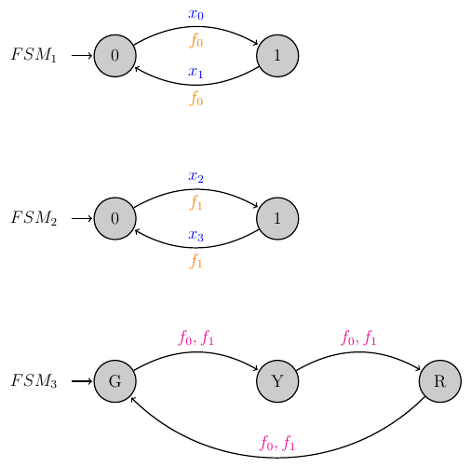
McFSM, PubSub and Observer
McFSM combines features of PubSub, Observer and Recursive Functions.
The “output-events” f₁, f₂ act like “topics” of PubSub.
Other FSMs (FSM₃) subscribe to these topics f₁, f₂ without the publisher having to know about it.
McFSM extends Observer by making state-transitions of all participating objects, subject and observers, visible.
The internal event distribution via XQueue is synchronous like in Observer.
XQueue has a fixed protocol which resembles the stack of “Recursive Functions”, bringing their power into the realm of FSMs.
The state space of the McFSM is the product of the state spaces of its FSMs, which may be huge.
All properties are known at compile-time.
McFSMs are special FSMs and can be used as such in other McFSMs.
Notes:
McFSMs have been invented as a solution to problems with the Observer Pattern.
The term “without the publisher having to know about it” has to be taken with a grain of salt, because there is nothing dynamic here, all connections are fixed at compile-time and the IDE (currently) has to know about everything.
But the statement is still true, since we have a class-concept in the DSL that really allows each FSM class to be implemented without knowledge of its potential uses.
Having McFSMs as FSMs in another McFSM, makes the state-space of the latter even huger.

Slide 31
McFSM, PubSub and Observer
McFSM combines features of PubSub, Observer and Recursive Functions.
The “output-events” f₁, f₂ act like “topics” of PubSub.
McFSM is “Observer done right” making everything visible.
All properties are known at compile-time => allows proofs.

Slide 32
Making it work
A simple idea often needs a complex realization.
Like Databases, McFSMs require many work-packages:
 | McFSM | Database
simple idea | FSMs + Coupling | Tables + Join
theory | welldefinedness, reachability, … | queries
theoretical structures | XQueue event-distribution | B-trees
internal data-structures | SQLite, code-generators, … | query-planners, …
result | Code generation | Library + binary code
creation | DSL to create FSMs, McFSMs, … | SQL to create tables, views, …
combination | DSL for coupling, conditions, … | SQL for JOIN, SELECT, …
debugging | DSL for assertions, reachability, … | PRAGMAs & Co.
extension | Plugin interface | Virtual tables
UIs and tools | IDE | DB manager, GUIs
… | … | …
Notes:
From the simple idea there is a long way to go, to get to a useful working system!
We need interpreters, internal data-structures, user-interfaces, etc. – all working on a sound theory, which by itself has to be created first!
Not to mention the study of and comparison to all the competing alternatives! (SCADE, Esterel, ELM, Lustre, etrice, LTSA, Promela, QP, SineLbore, Scala.React, SPIN, TLA, Together, Yakindu, …)
(https://de.wikipedia.org/wiki/Thomas_S._Kuhn) ... a new theory, however special its range of application, is seldom or never just an increment to what is already known. Its assimilation requires the reconstruction of prior theory and the reevaluation of prior fact, an intrinsically revolutionary process that is seldom completed by a single man and never overnight. - Thomas Kuhn.

Slide 33
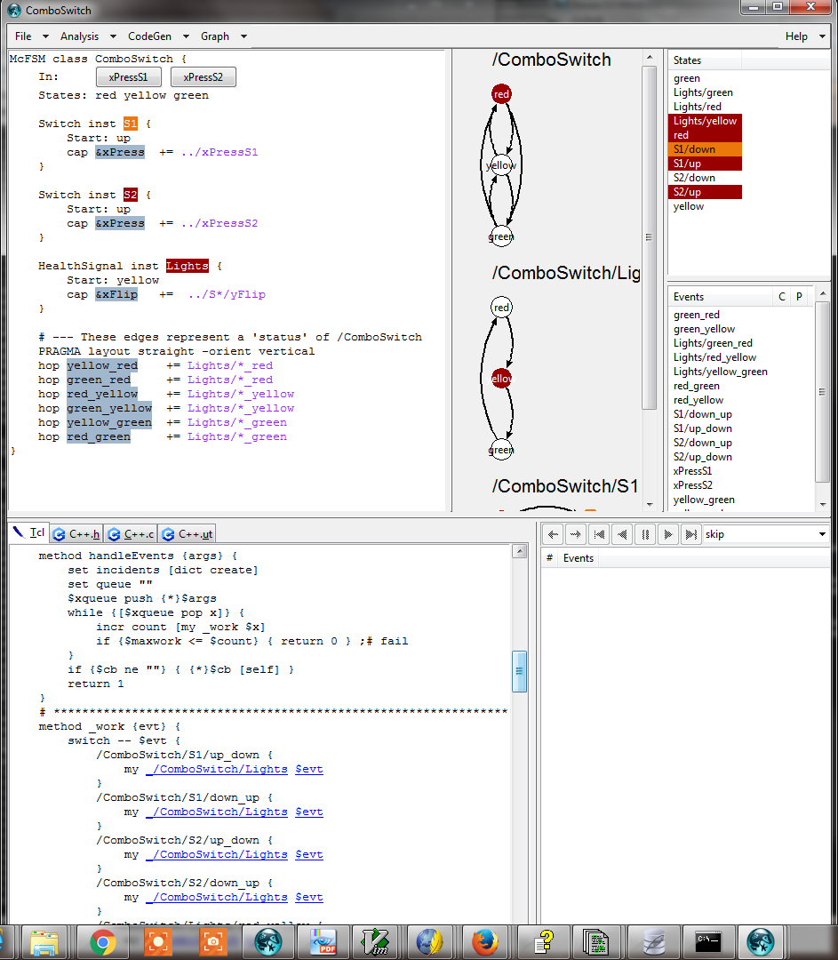
“McGen”-compiler - an IDE for McFSMs
McGen screenshots.
Notes:
c.f. our website. (screenshot 2017-03)

Slide 34
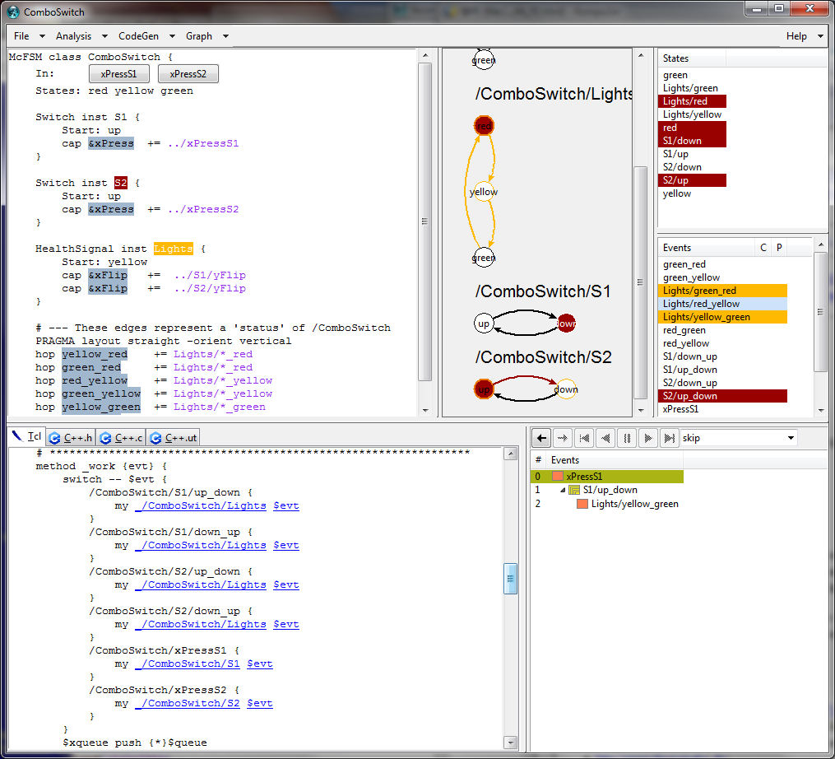
Notes:
(screenshot 2017-03)

Slide 35
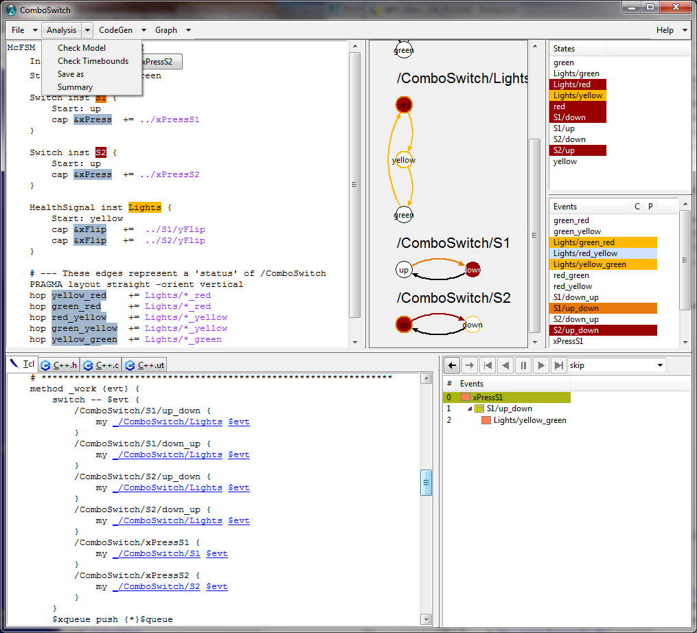
Notes:
(screenshot 2017-03)

Slide 36
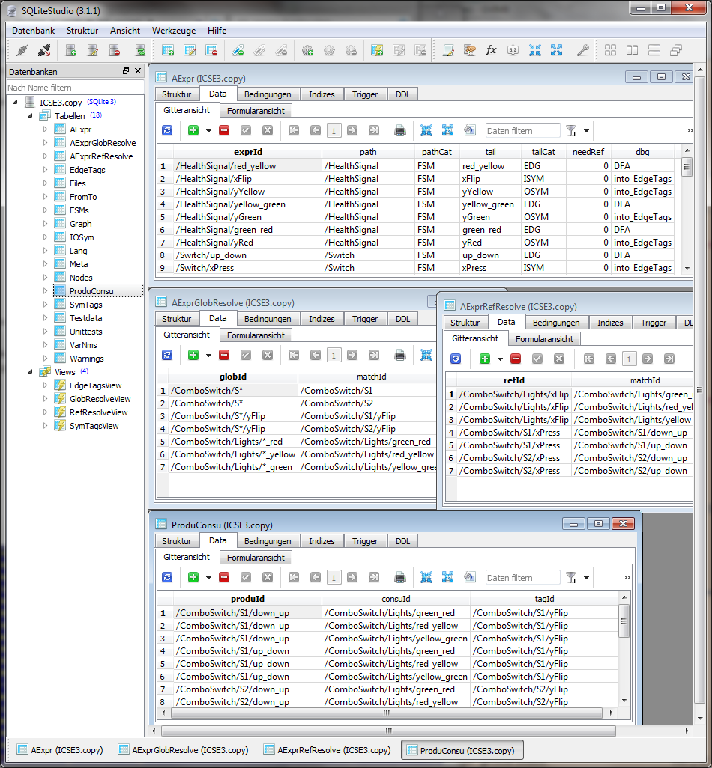
Notes:
(screenshot 2017-03)

