Slide 1
mathemaTcl – a collection of mathematical extensions
Arjen Markus
July 2017

Slide 2
Jalousie de métier
From a newsletter by the Numerical Algorithms Group:

Slide 3
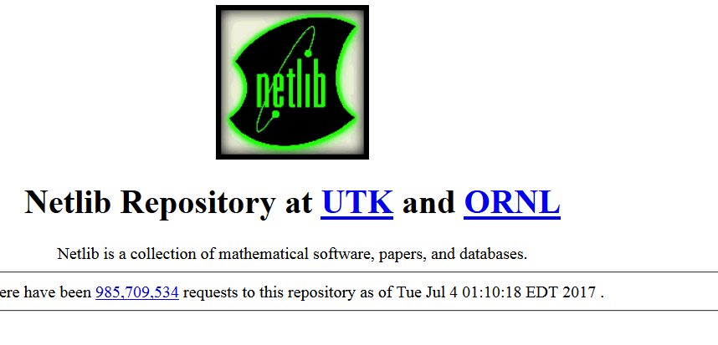
Lots of stuff out there
Venerable packages like LAPACK (linear algebra) and LSODE (ordinary differential equations)
Solving optimisation
problems
Tcllib has several packages
in pure Tcl, but …

Slide 4
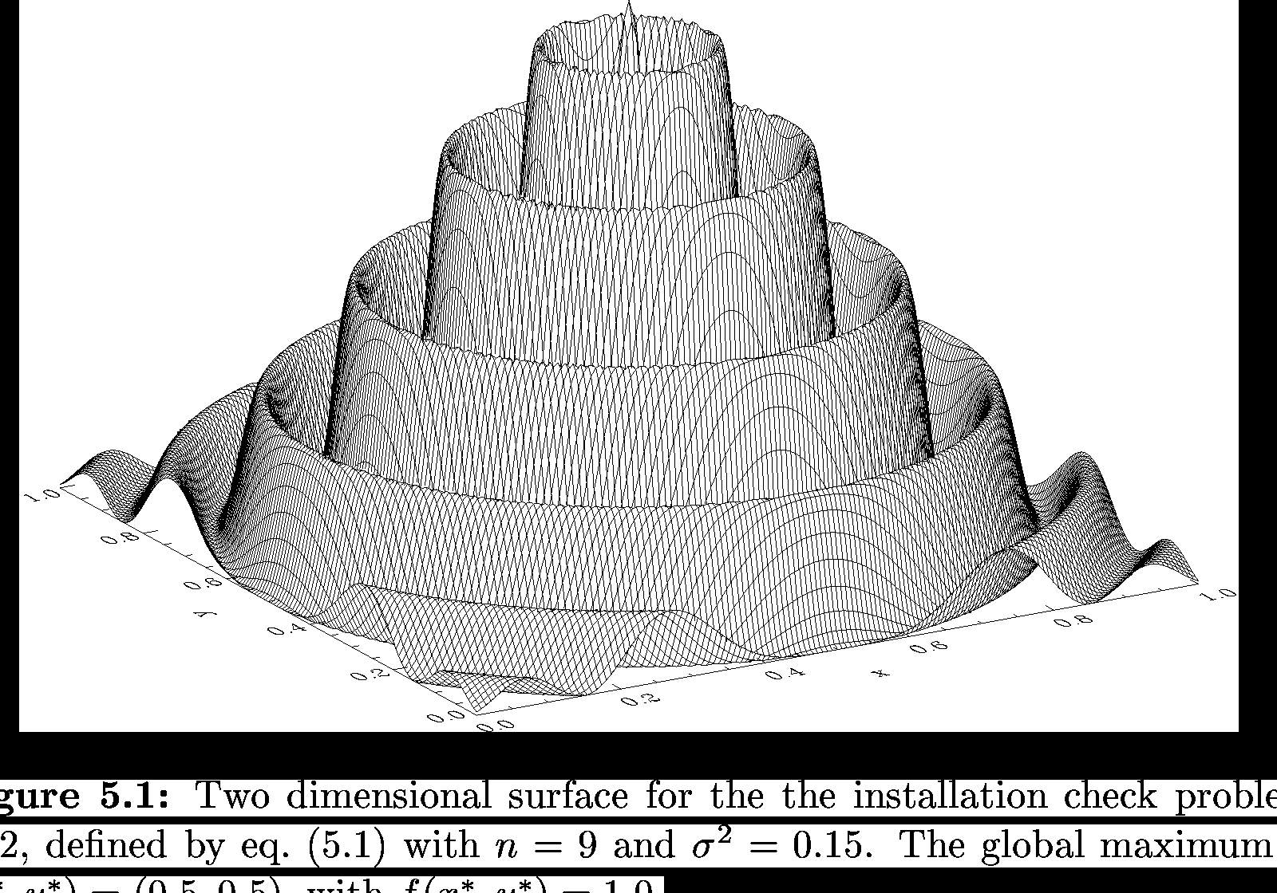
The idea
Wrap these libraries – written in Fortran (FORTRAN) and C
Make them available in source form with an easy-to-use build system and documentation

Slide 5
Choices I made
TEA: No Fortran support, difficult on Windows
But:
Mathematical/numerical libraries are
usually straightforward to build
So: use dedicated build script:
Identify suitable compilers and the Tcl libraries
Use simple makefiles

Slide 6
Requirements
Multiplatform
No surprises – no exit in the library
Interp-safe (if possible) – implies thread-safety
Comfortable Tcl API
From the source code of PIKAIA:
! ctrl( 1) - number of individuals in a population …
! ctrl( 2) - number of generations …
! ctrl( 3) - number of significant digits …
! ctrl( 4) - crossover probability; must be <= 1.0 (…)
! ctrl( 5) - mutation mode; 1/2=steady/variable (…)
! ctrl( 6) - initial mutation rate; should be small …
! Ctrl( 7) - …

Slide 7
Some examples (1)
Library of special functions: straightforward wrapping:
Wrapfort::fproc ::Cephes::gamma gamma_c {
double x input
double y result
code {} {
y = gamma(x);
if ( merror ) {REPORT_ERROR(merror);}
}
} double

Slide 8
Some examples (2)
Optimisation of a function implemented in Tcl: proc name passed to the library
Wrapfort::fexternal fcn {
fortran {
integer n input
double-array x {input n}
double f output
}
toproc {
x input
f result
}
}
Wrapfort::fproc ::Global::findGlobalMinimum global_wrap {
external fcn {}
double-array amin input
…
}

Slide 9
Some examples (3)
Lots of arguments or C structs:
hide the complexity via a front-end in Tcl and
option-value pairs
# pikaia --
# Run the simulation and return the result
#
proc ::Pikaia::pikaia {func min max args} {
set options [lrepeat 12 [expr {-1.0}]]
set printfile "pikaia.out“
… Fill list ”options” via args …
#
# Run the pikaia computation
#
set result [RunSimulation $func [llength $min] $min $max $options $printfile]
return $result
}

Slide 10
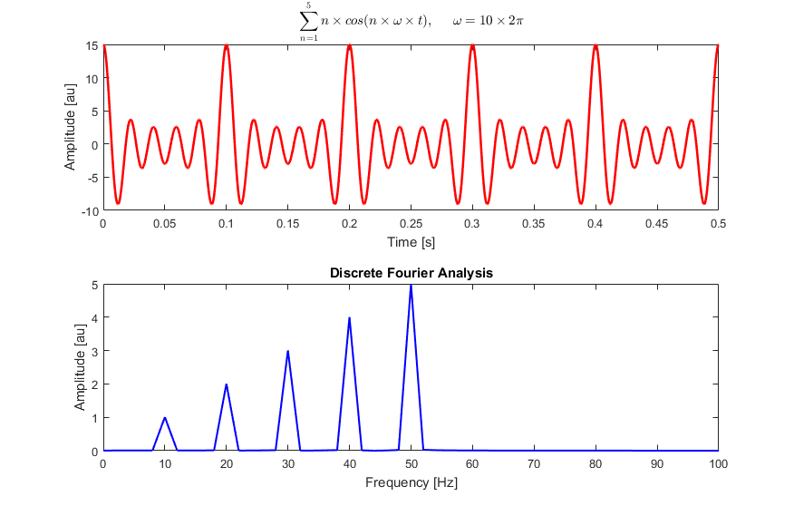
More complicated examples
FFTW3 (Fast Fourier transform):
First set up a plan
Then use this plan repeatedly
Solution:
Create a dedicated command
and use the ClientData for
storing the plan

Slide 11
Internal state
The most complicated issue
Capture it? Sometimes the library offers such an option
Modify the source code?
Or find a modernized version ☺
Always ad hoc solutions
COMMON /DINCOM/ X(100,20),HC(20),DXC(20),VMVT(20,19),EPSCO(20),
VMCOR(20),VCOR(20),XRMIC(100),XRMAC(100),XOPT(100),FOPTC,
IE(20),ISVT(20,19),KGEN,KTIM,NDIM,NTRAJC,NTRAJR,
ISEGBC,INKPBC,KPBR0C,NCF,IFEPC,INHPC

Slide 12
Status of the project
Tested using MSVC, Cygwin, MinGW, Linux
Several libraries wrapped:
Special functions and probabilistic functions
Optimisation
Partial ordering
Wavelets and FFT
Genetic algorithm
Many more to follow!
See Chiselapp

