Slide 1
TclQuadcode Status
Donal Fellows EuroTcl 2017

Slide 2
TclQuadcode is…
Native Code Compiler for Tcl (8.6)
Compiles procedures only
Not yet tackled methods
Probably never global scripts
Works ahead-of-time
Currently too slow for JIT
Using advanced technology
Quadcode engine uses results from some very recent papers
Based on Static Single Assignment analysis and type inference
Collaboration between Kevin Kenny and Donal Fellows
Kevin: High-level parsing, analysis, optimization
Donal: Low-level code generation, optimization
40k lines of Tcl (1.2MB)
Also 2.7kloc C++ (10kloc including generated) for LLVM interface llvmtcl
In Development!
Not yet finished…

Slide 3
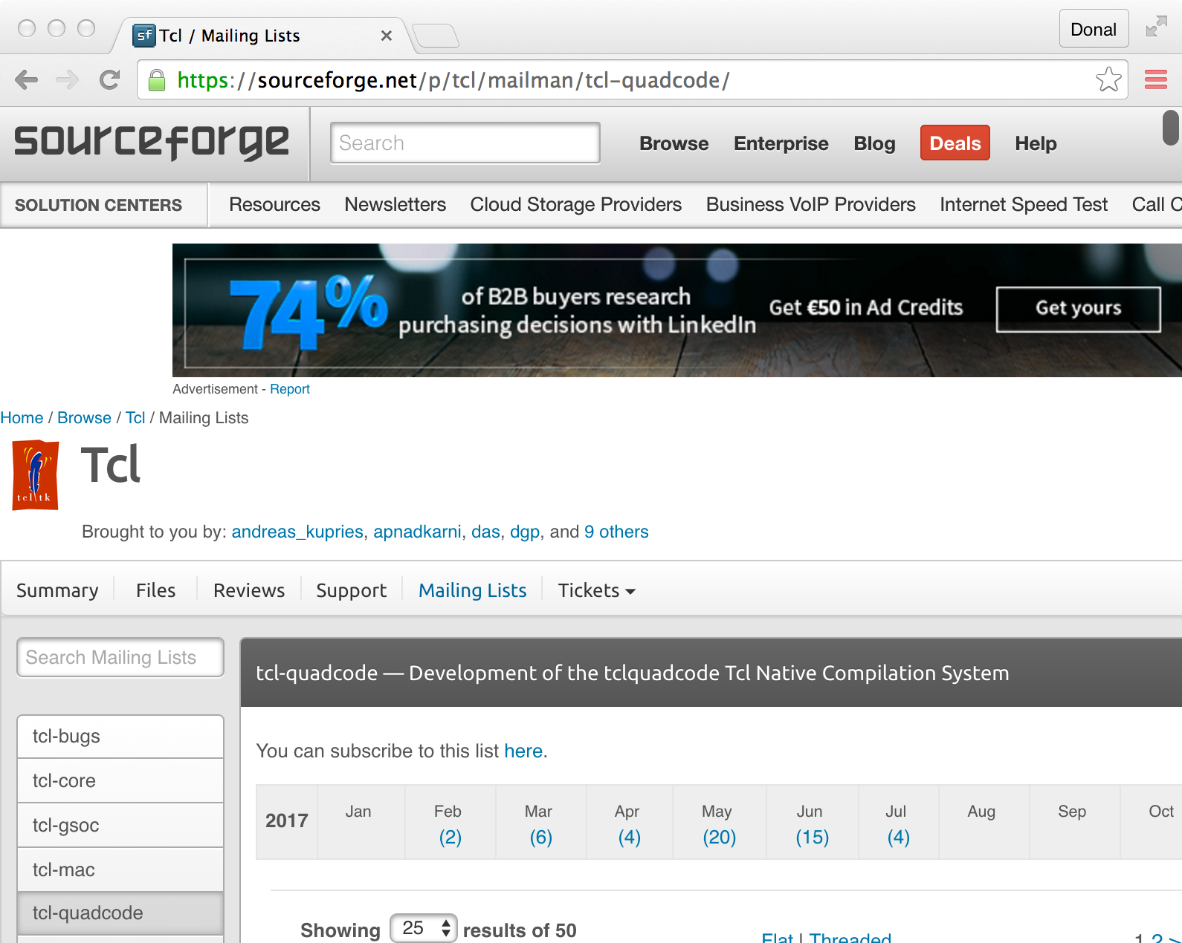
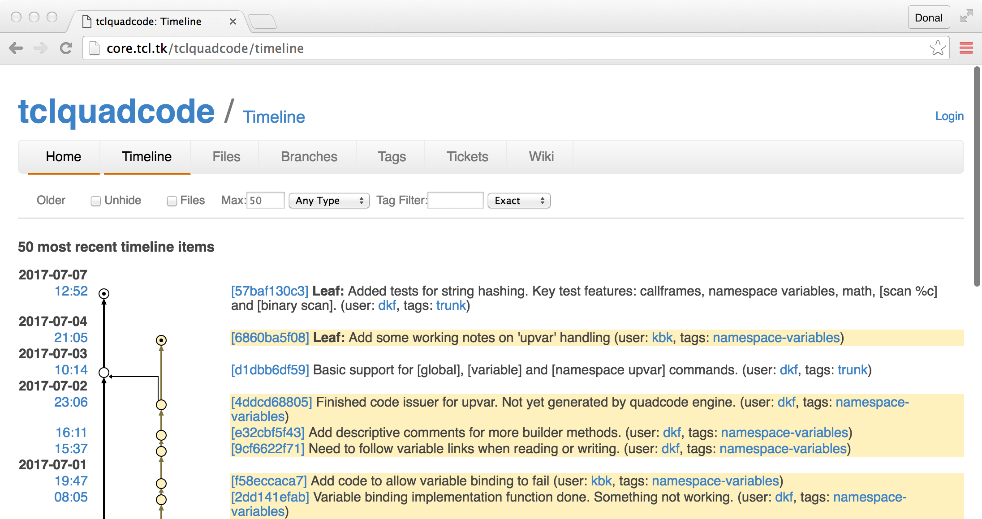
TclQuadcode online
Notes:
The URLs are
Mailing list: https://sourceforge.net/p/tcl/mailman/tcl-quadcode/
Fossil repo: http://core.tcl.tk/tclquadcode/

Slide 4
Why do this?
Tcl Bytecode Engine is Hitting a Performance Wall
Not very fast
Changes tend to make things slower
Internally insane structure (goto, goto, goto!)
Want to go faster
Might be possible to do a new bytecode engine to go perhaps a bit faster
Going much faster needs native code
This was in discussion between several Tclers for years
Kevin Kenny
Miguel Sofer
Don Porter
Myself
(Andreas Kupries?)
Some of us had more time than others
Notes:
The key discussion happened in the lobby of the hotel in New Orleans at a Tcl Conference. That was where we decided it was possible at all.

Slide 5
Why do this?
Key Events Triggered Action
We had some GSOC students
→ Bytecode assembler
tcl::unsupported::assemble
Showed we could do provably correct low-level work
Jos Decoster’s llvmtcl demonstrated bytecode→machine code
Very limited (32-bit ints only), very fast
Karl Lehenbauer put up bounty
Stimulated actually getting on with it!
Not doing it just for FlightAware, but for everyone
Long-Term Aim is to Support as Much of Tcl as Possible

Slide 6
Headline Speedups
Numeric Code
Up to 30 times faster!
General Simple Code
2–6 times faster
When the Optimizer Really Succeeds…
Over 100 times faster has been observed
Not sure much code will ever achieve that!
String and I/O-bound Code Sees Little Improvement
Tcl’s standard string implementation is fairly good

Slide 7
Selected Speedups from Demo
Example | Before (µs/call) | After (µs/call) | Speedup
fib 85 | 12.1382 | 0.346379 | 3404.30%
cos 1.2 | 5.93834 | 0.416172 | 1326.90%
wordcounter3 $sentence | 30.6436 | 5.49772 | 457.39%
H9fast $longWord | 47.6665 | 7.08957 | 572.35%
mrtest::calc $tree | 9.81424 | 0.800966 | 1125.30%
impure-caller | 111.956 | 1.03207 | 10747.70%
linesearch::getAllLines2 $problemSize | 1199.20 | 97.4374 | 1130.74%
flightawarebench::test $problemSize | 38582.7 | 1909.37 | 1920.70%
Timings to 6 significant figures using ~150 iterations. 100% speedup means twice as many calls per second.
All tests carried out on 2013 MacBook Pro with LLVM 4.0. Your mileage will vary. (Many tests slower, there to check correctness.)
Notes:
Fib is integer math, cos is float math, wordcounter3 is word counting using local dictionaries and lists, H9fast is doing per-character math on a string (hash function), mrtest::calc is interprocedural calling handling a little language, impure-caller is interprocedural testing that shows we can remove costly operations entirely, linesearch and flightawarebench are general math-heavy algorithms (in vector math and spherical coordinate computations, respectively) that are used for heavy testing.
The flightaware one is severely cut down from the one that will be used for $100k prize

Slide 8
How it Works
Procedure
Definition
(string)
Code out has same interface as input procedures
Function
Definitions
(native code)
Standard bytecode compiler
Optimise (inline code) and issue code
Procedure
Definition
(bytecode)
Standard Library
(LLVM IR)
Function
Definitions
(LLVM IR)
Quadcode impls
Basic convert
IR code issue
Procedure
Definition
(untyped quadcode)
Procedure
Definition
(typed quadcode)
Function
Definitions
(typed quadcode)
Type
Analysis
Quadcode specialise
Notes:
Purple is standard Tcl. Yellow is quadcode. Orange is LLVM/native.

Slide 9
Why it Works
Cost of Tcl code mostly due to overheads:
Memory management
Type checking
Value conversion
For example: Addition needs to
Check if arguments are numeric (throw if not)
Convert to actual numeric values
Perform the actual addition, choosing correct operation based on provided actual types
Store the result in a new Tcl_Obj* of the right type
Deallocate the references to the input values if they are no longer used

Slide 10
Why it works #2
We can use knowledge of operations’ inherent types to select better storage
Add two floating-point numbers? Get a float
Can do some type checks with string is
Key types allow much faster implementation
Key ones: bool, double, int64_t
Also, can trace effects of decisions
Many code paths in real code exclude others
Very useful for efficient memory management
Allows native code issuer to do many more optimisations

Slide 11
But There’s More!
Splitting Code Paths by Type within a Procedure
e.g., handle cases where addition is of an integer separately from addition of a double
Cross-Procedure Analysis
Procedures often only work with limited types
Not called with arbitrary input types
Produce restricted subsets of output types
Differentiation of Functions by Type
Can have many functions per procedure
One is always classic callable-from-anywhere
Produces usual standard errors as expected

Slide 12
Subtle Changes Help Speed
Slower Version
Faster Version
Gets ~170% speedup
Slow way to do this…
proc Hslow s { variable n foreach c [split $s ""] { incr h [expr { [scan $c %c]*$n**[incr i] }] } return [expr {$h&0xFFFFFF}] }
Gets ~570% speedup
Slightly faster originally too
proc Hfast s { variable n binary scan $s "cu*" chlist foreach c $chlist { incr h [expr { $c * $n**[incr i] }] } return [expr {$h&0xFFFFFF}] }
Taking best advantage may require changing your code.
Notes:
Version with [scan] is worse because of list/int conversions, but even doing it “properly” still isn’t as fast as [binary scan]; hoisting access to callframe out of loop is a big win.
Test was with 39-character word.

Slide 13
Recent Work
Can now Call most Standard Tcl Commands
We synthesize a call frame where required
Local variables stored in call frame during call
Callee can read and write variables scan $someStr "(%d,%d)" x y
Allows use of most of Tcl (if not always efficiently)
Get access to Global and Namespace Variables
Support most non-local variable access:
global x y
variable p
namespace upvar ::ns vbl1 e vbl2 f

Slide 14
Down Sides
Compilation Time is Long
39 seconds to compile our full set of tests (145 procedures)
Times depend on hardware speed
Much scope for improvement
Amount of Code Generated can be Large
145 procedures → 578 functions
25kB Tcl code can expand to 12MB or more object code
Memory footprint?
Large number of functions, some of which are very long
Stresses downstream compiler
Incomplete Coverage of Tcl
At least this one is to be expected…
Compilation Time Breakdown
Procedure Registration & Initial Quadcode Analysis: 6.5 s
Procedure Specialization (High-Level Optimisation): 10.4 s
Quadcode to LLVM IR Conversion: 7.0 s
LLVM ‘Classic’ Optimisation: 7.9 s
LLVM Assembly (LLVM IR to Machine Code): 6.4 s
Prospects for Improvement
Items 1–3 written in Tcl
Compile the compiler?
Write parts in C or C++?
Items 4–5 already in C++
Different back-end engine?
Notes:
The LLVM stages are much slower in LLVM 3.9; 4.0 is a great upgrade for us.
Don’t know the exact amount of object code; the object code dumping engine is on a branch.

Slide 15
Next Steps
More Variable Access Work
Non-hacky arrays
Currently convert internally to dictionaries
Fully-qualified names: $::tcl_platform(os)
Dynamic names: set x [set ${a}_${b}_${c}]
Aliased named: upvar 1 $theirs ours
Local aliased named: upvar 0 varX varY
Embedded Script Fragments
Caller supplies script
Callee uses [uplevel] to run script
Want to do right thing when inlining
Release Alpha Version!

Slide 16
After the Alpha
More Types
Lists, dictionaries, bignums, minor types
TclOO Methods
Different basic type signatures
Command resolution different
Variable resolver commonly used
Lambda Terms
Not sure how best to do this (no names)
Non-Recursive Engine Awareness
Support for yield and yieldto
JIT Compilation
Code generation in background thread?
Runtime library sharing?
Back-end issuer other than LLVM?
Not as fast, but might be better in practice
Optimise the Compiler itself
Key data structures may be better off in extension
Look for “Spin-Off” Technology
Features that can become part of ordinary Tcl
Notes:
Everything on this slide is entirely speculative

